Slide 1
Attendance Matters
Attendance Matters
Thrive by Five

Slide 2
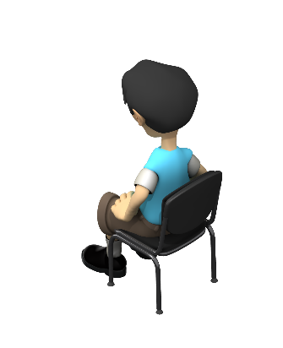
Is 90% good for a child’s attendance?.
Question?
Mrs. Miller
We want our children school ready.

Slide 3
Answer:
That would mean that if a child had a 90% attendance –he would be missing a ½ day once a week for a month
Mrs. Smith
Do we want our children having this same school/work ethic for the rest of their lives?
Attendance Matters

Slide 4
Today’s Objectives
Mr. Shepherd is mean.
Mr. Shepherd
Defining Average Daily Attendance
Develop Strategies For ADA Compliance
Review Policy For Chronic Attendance
Developing Case Notes
Strategies to increase ADA
School Readiness.

Slide 5
Defining Average Daily Attendance
Develop Strategies For ADA Compliance
Review Policy For Chronic Attendance
Strategies to increase ADA
Developing Case Notes
Workshop Objectives

Slide 6
Developing Systems
Notes:
Systems deal with the concept when all things within that system the proceedures and processes work together the outputs of that system will produce uniformed, and standardized.
When the system works optimally it maximizes the outputs by creating and placing the parts together with expertise which yields a maximized product.
Does your system create a uniformed product or has it been maximized through a collaborative approach?
Head Start has a system that creates opportunities to connect people with experise. We learn to take cues from which are verbal but many time non-verbal. Attendance gives many non verbal ques through patterns.

Slide 7
Integrated Services
When absence patterns begin to develop in a child attendance, staff should be concerned. As the absence patterns emerge they may give a snapshot into the family structure or dynamic.
However, some patterns may be cause for other professionals to be called for their expertise to ensure the safety of all children, staff and other Head Start families.
When would you make contact to another Head Start Specialist regarding a child’s attendance.
Notes:
Talk about health issues and attendance and how they are monitored

Slide 8
What Do we follow as the rules?
Head Start Act
Head Start Performance Standards
State Law or Administrative Law
Grantee Policy or Contract
Delegate Policy
Notes:
The formula that is known as Average Daily Attendance is for center based programs. This means families and children being provided Head Start or Early Head Start services within a classroom setting. This does not include socializations or home visits using this formula.
The Head Start Performance Standards indicate that this is not necessarily an issue of compliance when delegates are below 85%. However, what it indicates is that a study must be done to analyze the patterns and reasons why 5 he absence are ocurring. Tell me why the child is chronically absent.
Often FSW use the term sick as a catch all to easily understand why children were absent. But when children are frequently I’ll the health specialist or nutrition Specialist are aware if the system is actually working.

Slide 9
45 CFR 1305.8
(a) When the monthly average daily attendance rate in a center-based program falls below 85 percent, a Head Start program must analyze the causes of absenteeism. The analysis must include a study of the pattern of absences for each child, including the reasons for absences as well as the number of absences that occur on consecutive days.
Notes:
The formula that is known as Average Daily Attendance is for center based programs. This means families and children being provided Head Start or Early Head Start services within a classroom setting. This does not include socializations or home visits using this formula.
The Head Start Performance Standards indicate that this is not necessarily an issue of compliance when delegates are below 85%. However, what it indicates is that a study must be done to analyze the patterns and reasons why 5 he absence are ocurring. Tell me why the child is chronically absent.
Often FSW use the term sick as a catch all to easily understand why children were absent. But when children are frequently I’ll the health specialist or nutrition Specialist are aware if the system is actually working.

Slide 10
Daily Sign in Sheets
CACFP (Child and Adult Care Food Program) aka: Meal Attendance
Child Plus Database
Reports
Case Notes

Slide 11
Sets need for children to be in the program 85% of the time to get optimal benefit of program
When attendance falls below 85% an analysis must be completed to include tracking, patterns and well documented efforts
Attendance Follow-up
When to terminate families from program
Policy ERSEA 6
Notes:
85% is the goal that This program is working to use to maintain attendance. This makes us aware that children will only be able to receive the benefits of the program through daily attendance.

Slide 12
Remember….
Head Start is here to support families needs while receiving services through actual participation.
When a family decides they no longer want to attend the program they may withdraw at any time
When a family is not participating in the program, and the program (staff) does not see the family participating in the program, the slot must be vacated. 1305.
Families have 10 days to communicate or contact program
Program must fill the vacant slot within 30 days.
The program (delegate) may be charged by the grantee or OHS for slots vacant more than 30 days.

Slide 13
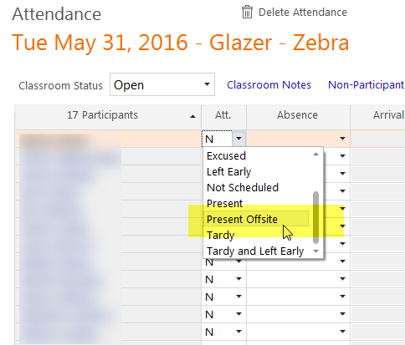
NEW

Slide 14
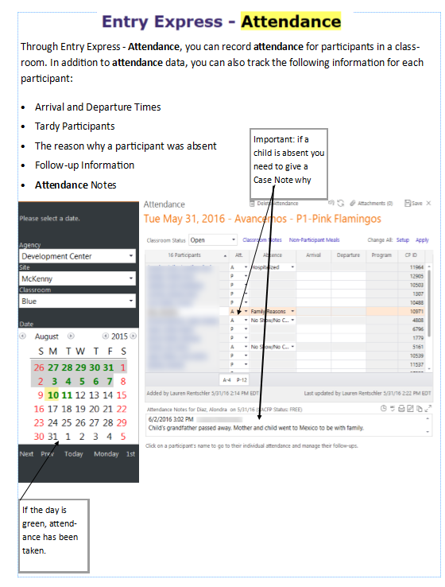
A-Absent
P-Present
N-Non-Schedule Day (only for Home Visitors

Slide 15
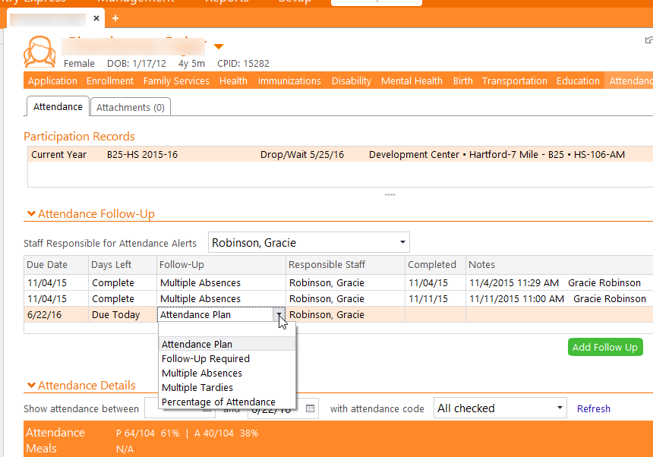

Slide 16
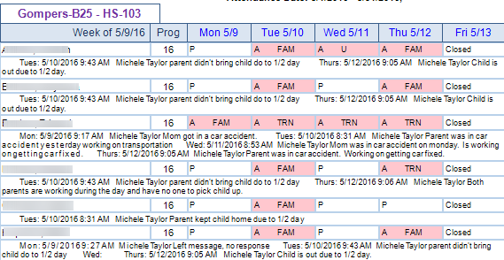
Report 2310
Case Noting

Slide 17
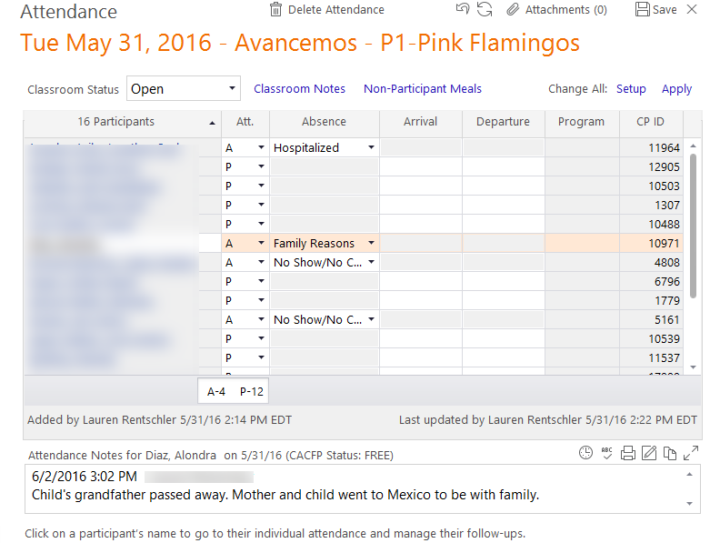
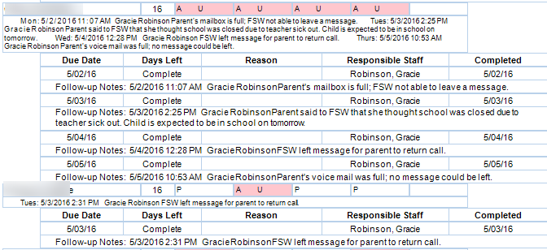

Slide 18
Class Closures
Only CSI can close classrooms—please notify your Data person if a classroom/building has to close down
Important: if your class closes down for a reason—it must be noted in classroom Notes- Explain in detail why your class was closed.
Cancelled– If it is weather related or building issues
Closed– Pre-Planned Delegate closing
Holiday-Christmas, New years even etc.
Teacher workday-i.e. High scope training

Slide 20
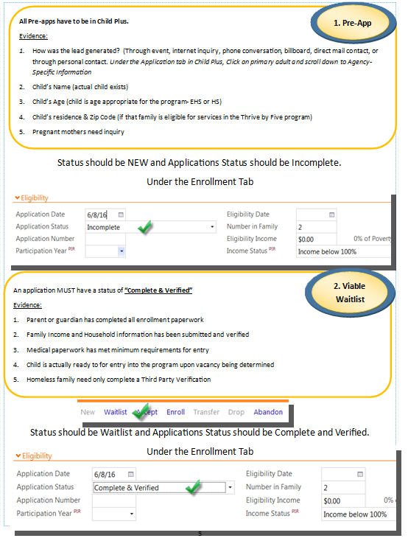

Slide 21
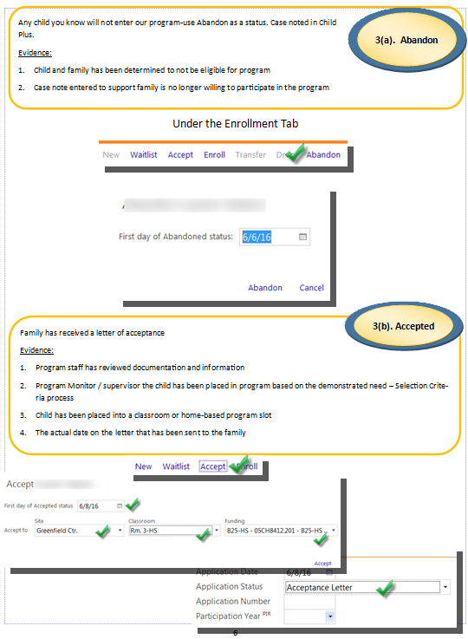

Slide 22
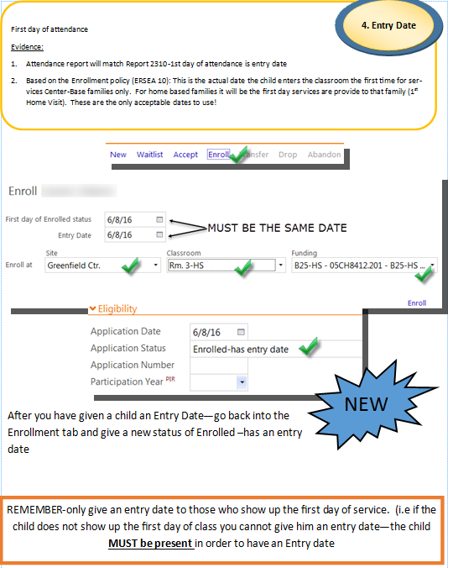

Slide 23
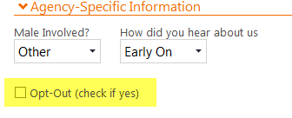
Darlene wants to show you some upcoming new things in Child Plus

Slide 25
Online Application—go to Thrivebyfivedetroit.org Click on Contact Us

Slide 27
1 Fed.Reg/Vol.52 NO 81
The “Number Present” is defined as children who are in class for any part of the classroom day and children who are not in class but receiving Head Start services during the day at another site.
3 OHS – PC – I – 064 | September 17, 2007
In calculating average daily attendance does a program use funded or actual enrollment?
Average daily attendance is calculated by dividing the number of children attending the program on any given day by the number of children enrolled (excluding vacancies) in the program on that same day.
2 Funded Enrollment
is defined as the number of children whom the grantee has been funded to serve and , as indicated in the approved application or, if applicable as negotiated between the grantee and the Head Start program office
ADA Formula:
ADA = Number Present
Actual Enrollment
Notes:
The goal of Office of Head Start and their position is that the Funded enrollment and Actual Enrollment should be the same. Programs have a responsibility to be fully enrolled on day one of the program year and no later than the end of the 1st program month. However, when a program does not meet its full enrollment than we have to lean on the guidance to ensure we have a percentage that will accurately depict the success of the program.

Slide 28
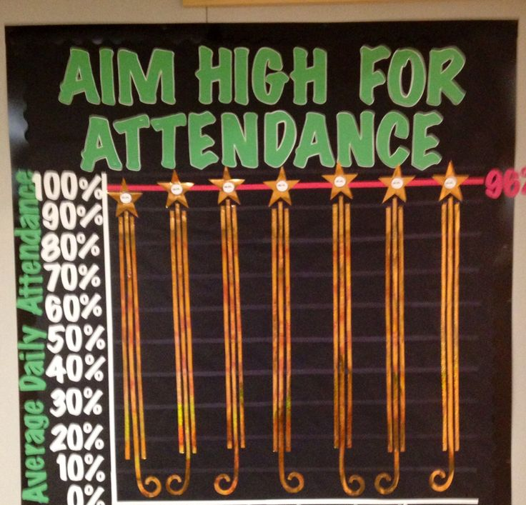
What’s the Answer?
Discussion Note:
Center: ABC
Funded Enrollment 96; 5 Classrooms
Enrollment: 88
Notes:
Center: ABC
Funded Enrollment 96; 5 Classrooms
Enrollment: 88
Attendance for 4/28/2014 was 72
Method: 72/88= ADA=81%

Slide 29
Ghost Children.
Mr. Shepherd
School Readiness.

Slide 30
ATTENDANCE PO PO
What is Chronic Absence?
“Missing 10% or more of school for any reason – excused, unexcused, etc. It is an indication that a student is academically at risk due to missing too much school starting in Kindergarten.”
“Reducing Chronic Absence: A Springboard for Academic Success”,Chang, Hedy, www.attendanceworks.org, Spring s014

Slide 31
Corey Shepherd
Ghost Children
Programs that try to hold on to children who have been enrolled, but they are no longer participating in their program. This misrepresents the actual enrollment of the program, by not dropping or withdrawing a child who does not participate in the program. These slots are typically held longer than 30 days.
IF A CHILD IS ENROLLED BUT NOT ATTENDING, AND FAMILY DOES NOT COMMUNICATE, OR HAVE PROVIDED A REASONABLE TIME FOR WHEN THE CHILD SHOULD ACTIVELY RETURN TO PROGRAM THIS CHILD SHOULD BE DROPPED OR PLACED ON THE WAITING LIST.
Please review the Thrive by Five policy to ensure you do not have fraudulent numbers represented in your agency.
Notes:
These children are identified in the attendance tracking systems. Sometimes we forget to drop children from our roles, but that contributes to an inflated number of children who are not getting services.

Slide 32
Notes:
i. In the event a child has been absent for 10 days with no communication, a letter of termination is sent to the family stating that the child will be moved to the waitlist or the slot has been vacated.

Slide 34
Notes:
i. In the event a child has been absent for 10 days with no communication, a letter of termination is sent to the family stating that the child will be moved to the waitlist or the slot has been vacated.

Slide 35
45 CFR 1305.8
(b) If the absences are a result of illness or if they are well documented absences for other reasons, no special action is required.
If, however, the absences result from other factors, including temporary family problems that affect a child's regular attendance, the program must initiate appropriate family support procedures for all children with four or more consecutive unexcused absences.
These procedures must include home visits or other direct contact with the child's parents. Contacts with the family must emphasize the benefits of regular attendance, while at the same time remaining sensitive to any special family circumstances influencing attendance patterns.
All contacts with the child's family as well as special family support service activities provided by program staff must be documented.
Notes:
(b) If the absences are a result of illness or if they are well documented absences for other reasons, no special action is required. If, however, the absences result from other factors, including temporary family problems that affect a child's regular attendance, the program must initiate appropriate family support procedures for all children with four or more consecutive unexcused absences.
These procedures must include home visits or other direct contact with the child's parents.
Contacts with the family must emphasize the benefits of regular attendance,
while at the same time remaining sensitive to any special family circumstances influencing attendance patterns.
All contacts with the child's family as well as special family support service activities provided by program staff must be documented.

Slide 36
Let’s get our children to school

Slide 37
CASE NOTES
Case Notes gives your file and work a voice.
Captures relevant data
Who?
What?
When?
Where?
Why?
Provides a snapshot of the event

Slide 38
CASE NOTES
Case Notes should be clear and concise
Accurate and brief
Timely
Readable and acceptable grammar
Avoid:
Diagnosis
Clichés, street talk and industry jargon

