Slide 2
2017-Thrive by Five Detroit
Looking Back…

Slide 3
Some of our trainings
Grantee Pre-Service
Program Governance
Parent Corp
Curriculum Training
ERSEA 101
Diversity
Family Engagement
Leadership Retreat
Forms Training
Excel Trainings
Child Plus Policies
Active Learning
STEM
Curriculum Training
ERSEA 101
MCIR
Reflective Supervision
HS Lesson Plans
Customer Service
Impacting Child Outcomes
ChildPlus – multiple functions
Monitoring & Metrics

Slide 4
We have had approximately 1286 staff come through our trainings!!
Trainings

Slide 5
Grants
CFSEM 2015/2016 Final Report
CFSEM 2016/2017 1st Interim Report
DEHS COLA Application
Birth to Five COLA Application
RFP for Southwest Solutions’ DEHS Slots
DMC Final Report
DEHS Baseline Application
Birth to Five Continuation Application
Hearst Final Report
CFSEM 2016/2017 2nd Interim Report
Kresge – Received extension of grant award through June 30, 2018
CFSEM 2017/2018 Application Submitted (Thank you Development Centers!)
Birth to Five Carryover Application of 2014 Unobligated Start Up Funds for 2017
Birth to Five Carryover Application of 2014 Unobligated Start Up Funds for 2018
Birth to Five Carryover Application of 2014 Unobligated Start Up Funds for 2017 (2nd Application)
Birth to Five Carryover Application of 2014 Unobligated Start Up Funds for 2018 (2nd Application)
Birth to Five Carryover Application of 2016 Unobligated Funds for 2017
Birth to Five Carryover Application of 2016 Unobligated Funds for 2018
Birth to Five Carryover Application of 2017 Unobligated Funds for 2018
Ascend Final Report
Non-Federal Share Waiver DEHS
Non-Federal Share Waiver Birth to Five

Slide 6
19.9 Million
Approximate Grants Totals

Slide 7
Coaching
HighScope Certified Teachers & Model classrooms
3 TOT's-1 on the way
Assessment Data used for individualized trainings.
Created Alignment tool for Practice Based Coaching & PQA.
Collaborate w/HIghScope
Created & Facilitated Trainings
Attended Practice Based Coaching 3day training in Chicago.
Attended & Presented @ HighScope International Conference.
Attended training on Professionalism & Leadership.
Set individual goals w/Teachers & gave feedback.
Completed all PQA's Pre-K.

Slide 8
Thrive by Five - Detroit
Revised all policies to reflect New Head Start Performance Standards.
Increased focus on Data Driven Culture Of Quality, across all levels
Classroom size capped @ 16 for Head Start
Increased the # of Community Partners.
Piloted Reflective Supervision
Successful monitoring visits w/Office Of Head Start.
Recognition from Region V... used as catalyst for other agencies.

Slide 9
Education | Disability
Partnered with Detroit Institute For Children
10% Increase in Kindergarten Readiness!!
Down to 16/Classroom in Head Start
Committee selected new Home Based Curriculum
Improved completion of PQA's & CLASS
Delivered 80+ hours of Professional Development around Education/Disabilities
Implemented Summer Screenings
Tightening Monitoring Processes at all levels
School Readiness Goals across all Early Childhood Programing

Slide 10
ERSEA
Hit 98% Enrollment
Updating ERESEA Policies w/New Performance Standards
Media:
Theater Radio
Web Recruitment Fans
Vehicle Wraps
ERSEA FACT
Ensured Fatherhood aligned w/C-52 On PIR

Slide 11
FCP
Updated FSA form to reflect PFCE Goals.
Trainings- Increased % of completed FSA's & FPA's.
Update & combined FSA's & FCP Policies.
Parent Corps Trainings & follow up for Family Service staff
Strong Policy Committee and Council presence
Increased community partnerships and services provided to parents

Slide 12
Health
· Reviewed ALL files for oral & dental screenings & increased PIR numbers!
· Staff trainings regarding new CACFP menus regulations
· Assisted in getting new HSAC started & hosted "Meet & Greet"
· Nutrition HSAC subcommittee started
·Child Care food vendors show.
· Good CACFP state review
· DC for health documentation in ChildPlus
· Health & Safety monitoring at all sites

Slide 13
HR
· Created a training resource file & delegate T & TA planning document in excel
· Create HR Policies & trainings based on past monitoring.
· Entered trainings in ChildPlus
· Created a Training Calendar for 2017/2018
· Updated the Contract with new performance standards
· Monitored HR records & policies showed strong compliance!

Slide 14
Monitoring | Data | Technology
Presented in Lansing
Social Media | Website
SAVS-PIR major improvements in process & completion
New file review
Captured Systems in CP
Attachments | Electronic Signature
Online Apps
Youtube tutorials
Shared information via Sharepoint and website
Revision of Forms

Slide 15
2017 – a year of achievement & change
We accomplished a lot individually and collaboratively in 2017. Take a few minutes with an elbow partner to share a success from this past year that makes you particularly proud.

Slide 16
Saying Goodbye
To Southwest Solutions

Slide 19
OUR MISSION
To provide quality, efficient and effective services to pre-school age children and their families in a holistic, innovative learning environment.
OUR VISION
The vision of TOFM Head Start is to help children and families through excellence and love. We do this by promoting education, self-awareness, self-sufficiency, financial literacy and exposure to local and global opportunities in a compassionate, safe, clean, professional environment that motivates and inspires while preparing them for life.

Slide 21
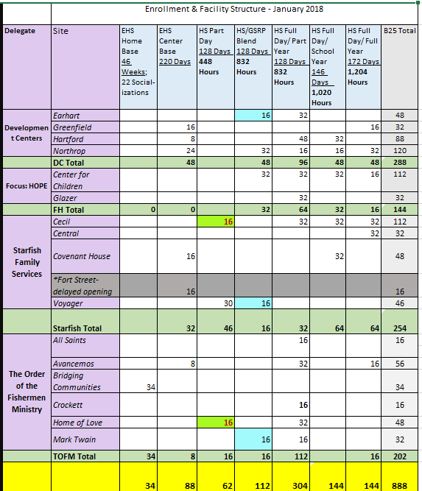
Facility Structure

Slide 22
Status of Service Delivery in Southwest Detroit
American Indian Health and Family Services will take over Home Based programming for 46 families
Development Centers will operate 3 existing classrooms at Earhart to ensure continuity of services
Development Centers will operate 2 additional Early classrooms under DEHS beginning in January
Focus HOPE will operate 2 additional Early classrooms and also serve 24 home based families from DEHS starting in January
Starfish Family Services will take over Head Start operations at Central and Voyaguer, 2 existing locations.
Starfish will also be opening 2 new locations: Covenant House and Cecil, to serve Head Start and Early Head Start
The Order of the Fisherman Ministeries will take over operations at All Saints, Crockett, Mark Twain and Avancemos
TOFM will also add a new site, Home of Love

Slide 23
Great Kids, Inc. (GKI), is dedicated to developing exceptional early childhood and home based programs for families with children 0-5 years. As an international leader, we have over 3 decades of experience in results-driven program implementation and management, program planning and evidence based curricula development and training tailored to meet program needs.
Home Base staff successfully completed the Growing Great Kids Prenatal to 36 Months Tier 1 Certification Seminar.
-This certificate qualifies this individual to use the Growing Great Kids Prenatal to 36 months Parenting and Child Development Curriculum and the Growing Great Families Curriculum with families.

Slide 24
-On-going effective use of the Growing Great Kids curriculum involves continued practice with the Growing Great Kids and Growing Great Families modules as they are designed. Staff skills for effectively supporting growth and change in families are incrementally and progressively built by the following process:
Developing motivation for learning a new skill
Creating many opportunities for practice
Acknowledging and accounting skills that are demonstrated
Provide time for staff to reflect
Providing feedback for enhancements
-Tier 2 staff development assignments are created to support specific skill development processes. Each month is laid out to focus on a Daily Do and Growing Great Families Module.
-Creating a new Home Base narrative based on GGK Home Visit Observation Form.

Slide 25
ParentCorps values families as partners in helping young children succeed!
ParentCorps 2018
1. Continue to provide Professional Development
training for staff on ParentCorps FUNdamentals.
2. Pilot Parenting Program at 2 sites (Focus:Hope & Development Centers)
3. Measurable outcomes based on the impact of ParentCorps strategies
and techniques.

Slide 26
Programming at some transition classrooms will begin the week of January 8
Other transition classrooms will open for programming after January 16
Update on Risk Management Status expected in February from OHS
Delegate Fiscal staff complete work on Carryover narrative in early January

Slide 27
Growing Great Kids implementation planning meetings will continue in January, as a support to Home visitors and their supervisors
Parent Corps Parent Program Pilot meetings will commence in late January
Anticipated expansion of Curriculum coaching program to meet new performance standards

Slide 28
Mental Health Activity
In recognition of all that we carry with us, and the critical importance of good mental health to delivering good leadership support to everyone counting on us,
we have devoted a part of our time together to attending to ourselves.

