Slide 1
The
becomes reality

Slide 2
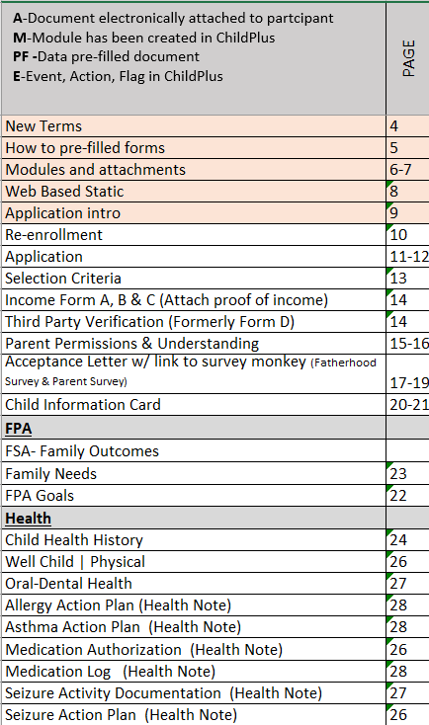
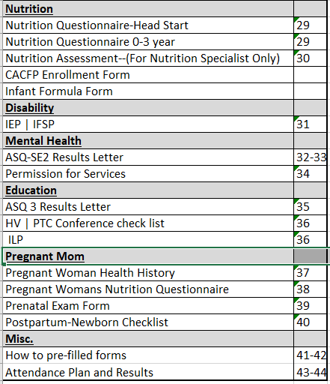
Page #

Slide 3
1
Modules
Attached to the Participant record as an Attachment
Put information into a Module and “Save As Attachment”
Pre-Filled
Pre-filled with Data from ChildPlus
You will have to go to a report #- example 1103 is prefilled application information and print out only what you need
Web base-Static
Static Forms
This is for emergency use-if you must go this route-you are still responsible for inputting the data into ChildPlus
Event
Information is still needed in ChildPlus
Example of this is you still need to create an Event, Action and Flag
Attachment
Would have to be manually attached
Example of this would be an IEP, Child Information Card, many of the Health requirements
2
3
4
5

Slide 4
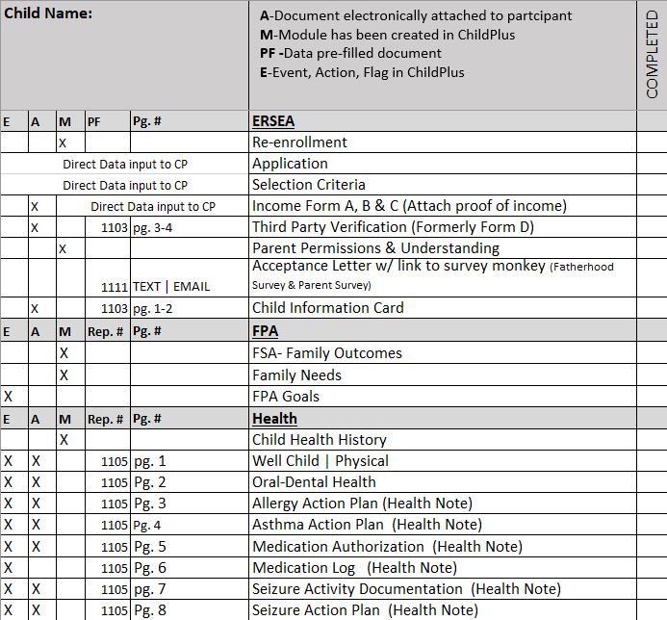
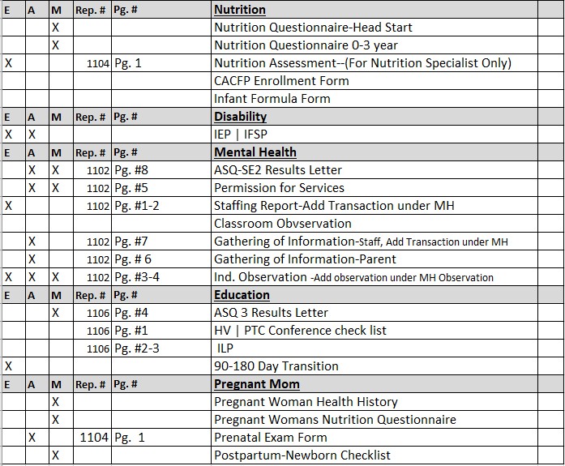
Participant check list

Slide 5
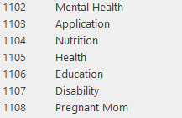
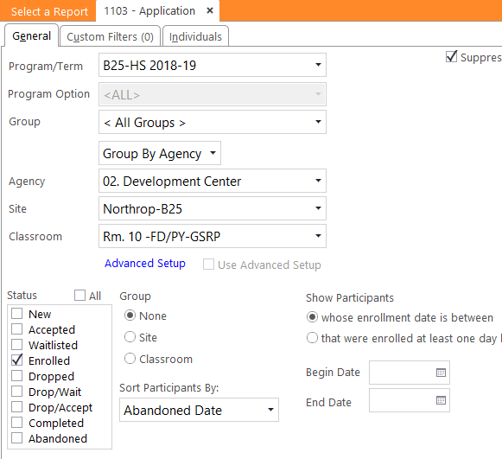
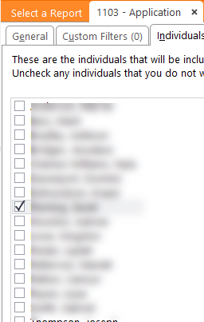
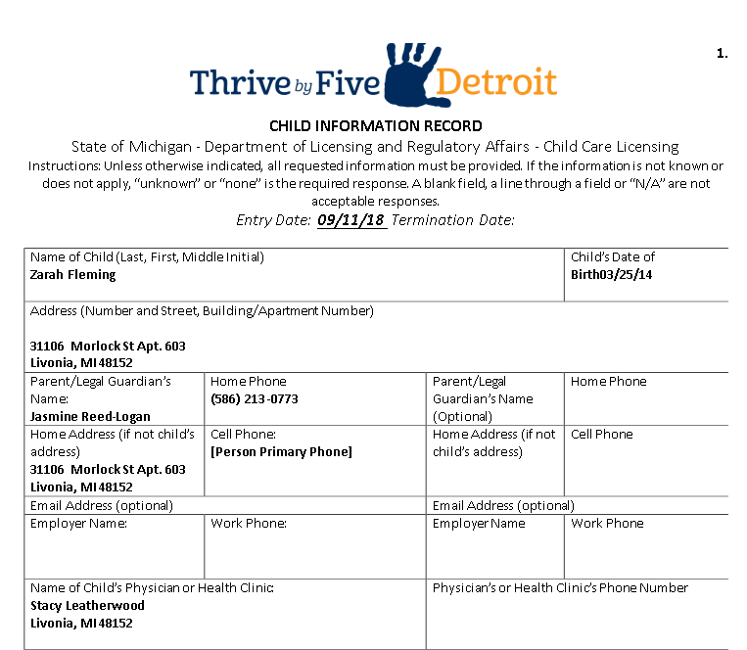
Pre-Filled Forms
1
How to get your Forms Pre-Filled with participate information
1
1
Report Numbers
2
1
3
4
Select Report number
To select a child drill down to their classroom
Click on the Individual tab –uncheck all children and select the child you need the information for.
End Result
_________________________________
Note you will se several reports in each content area. Look at the page numbers and just print what you need i.e. pg. 4-5

Slide 6
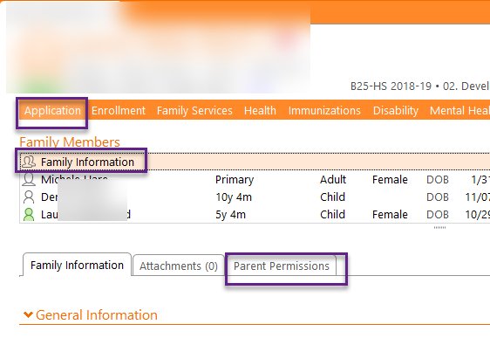
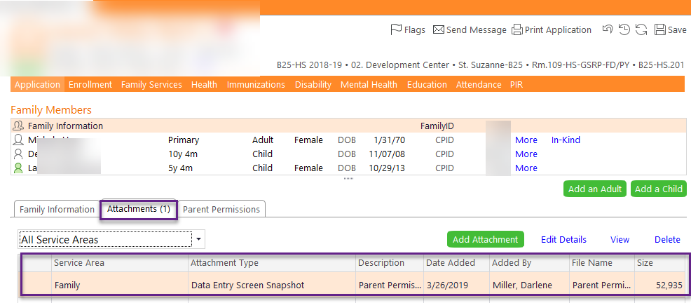
Modules-saved as attachments
2
PAPERLESS-the vision becomes reality
1
Pre-fill Forms
Fill out Parent Permissions with Parent-and sign
Save as Attachment
Result (NEXT PAGE)
PAPERLESS-the vision becomes reality
2
RESULT

Slide 7
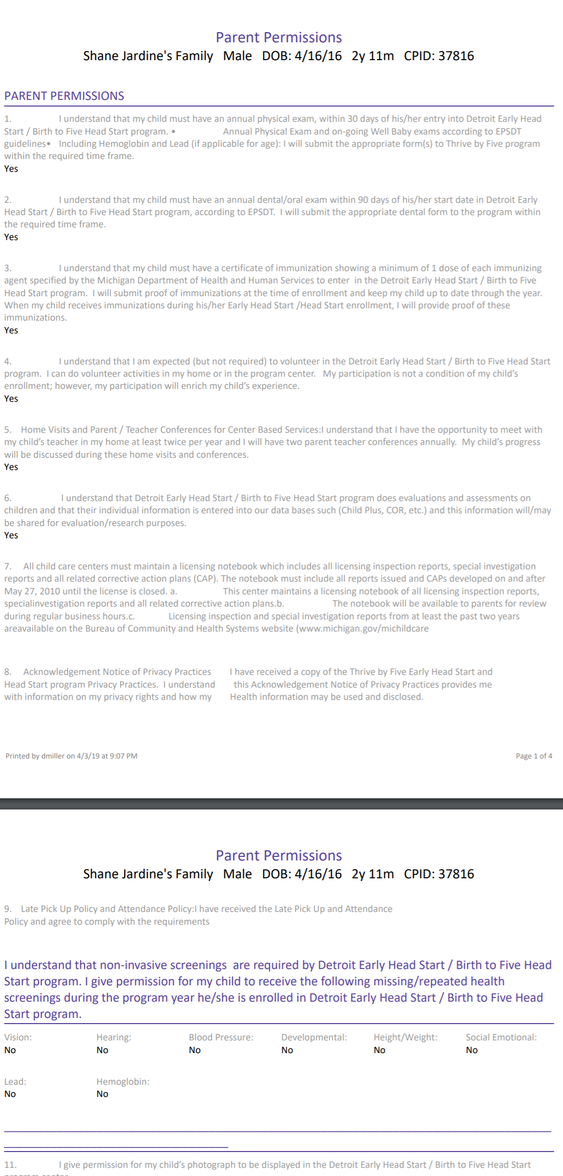
3
RESULTS

Slide 8
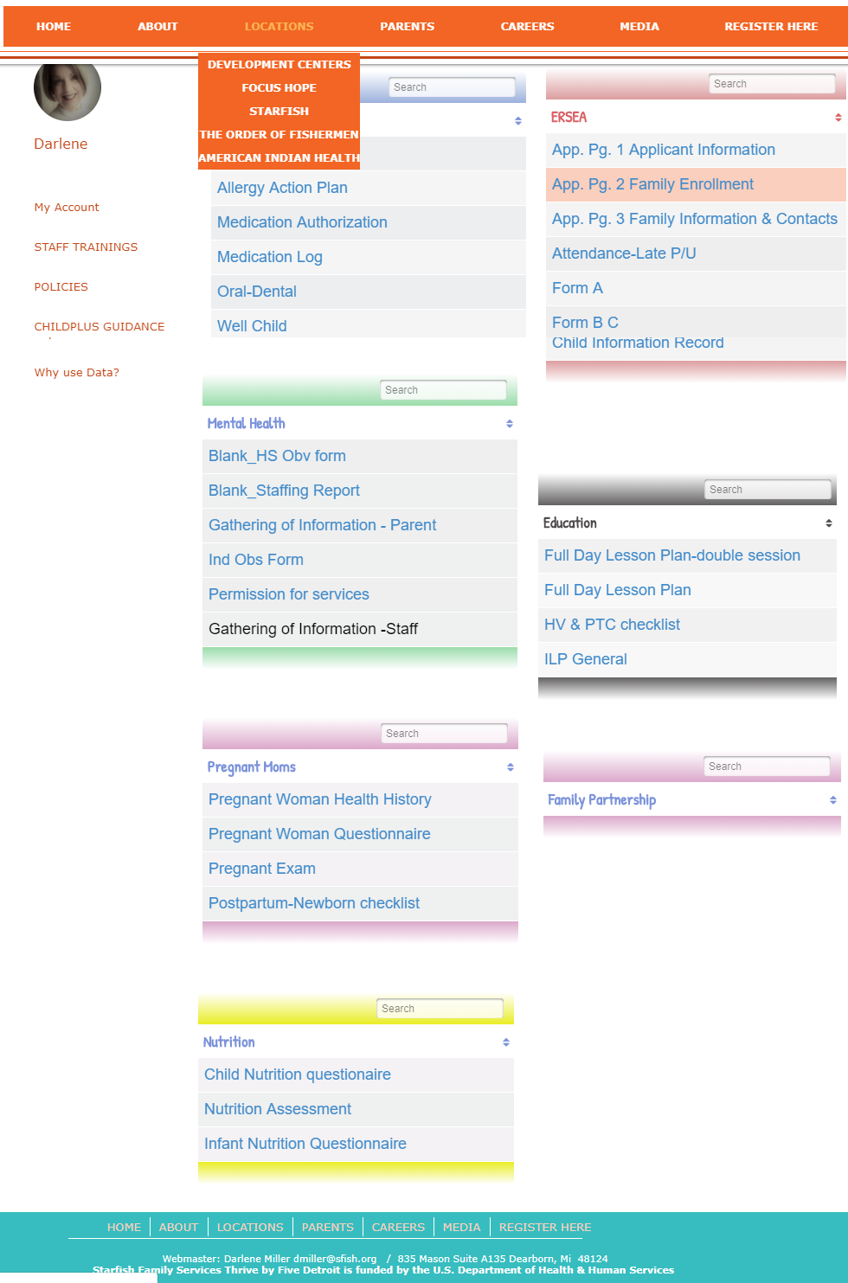
3
Web based—Static Forms
PAPERLESS-the vision becomes reality
PAPERLESS-the vision becomes reality
Pre-fill Forms
PAPERLESS-the vision becomes reality
Our Static Forms will still reside on our website: ThrivebyFiveDetroit.org-go to your account and scroll to “Forms”
IF YOU USE THESE FORMS – YOU ARE STILL RESPONSIBLE FOR INPUTTING DATA INTO CHILDPLUS

Slide 9
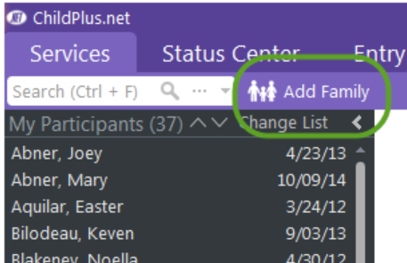
Application
PAPERLESS-the vision becomes reality
Adding applications in ChildPlus is fast and easy. Our Add New Family Application data entry screen instantly adapts to your data entry needs. And, because everything is located on one screen, you don't have to change screens while entering an application.
Getting Started
Everything you need to enter an application is located directly on the Add New Family Application screen. To speed up data entry and make it easier to find the information you are looking for, the Add New Family Application screen has 6 sections:
Family Members
Family Information
Family Income
Family Emergency Contacts
Enrollment
Immunizations
Pre-fill Forms
PAPERLESS-the vision becomes reality
Our Add New Family Application data entry screen instantly adapts to your data entry needs. And, because everything is located on one screen, you don't have to change screens while entering an application.
If you did not complete the full application (meaning the 6 steps above) you can always go back and fill them in.
Best Practices is to try and get it filled out all in the same setting

Slide 10
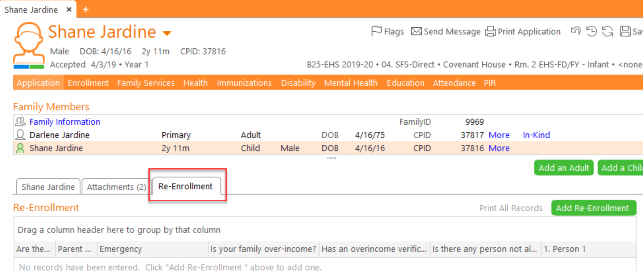
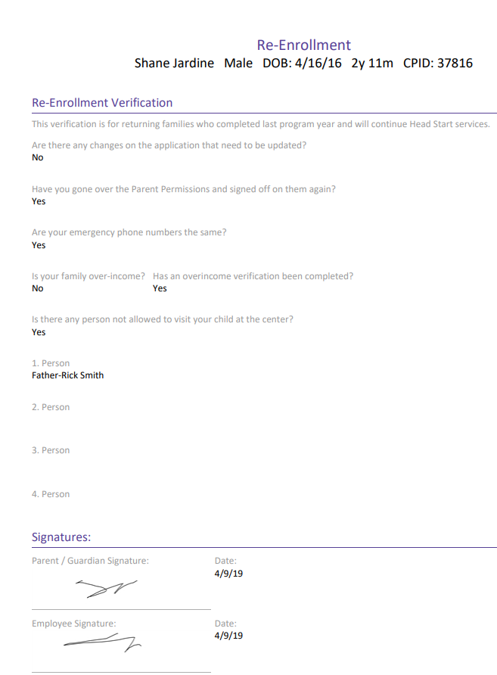
Re-Enrollment
1
2
3
4
5
6
7
Click on Participant
Go to the Application Tab
Click the Participant that is got a green shape
Click on the re-enrollment tab
Add Re-Enrollment
Complete data entry
Always save as an attachment
“result”
8
To get a print out of your results-always go back to your “Attachments”

Slide 11
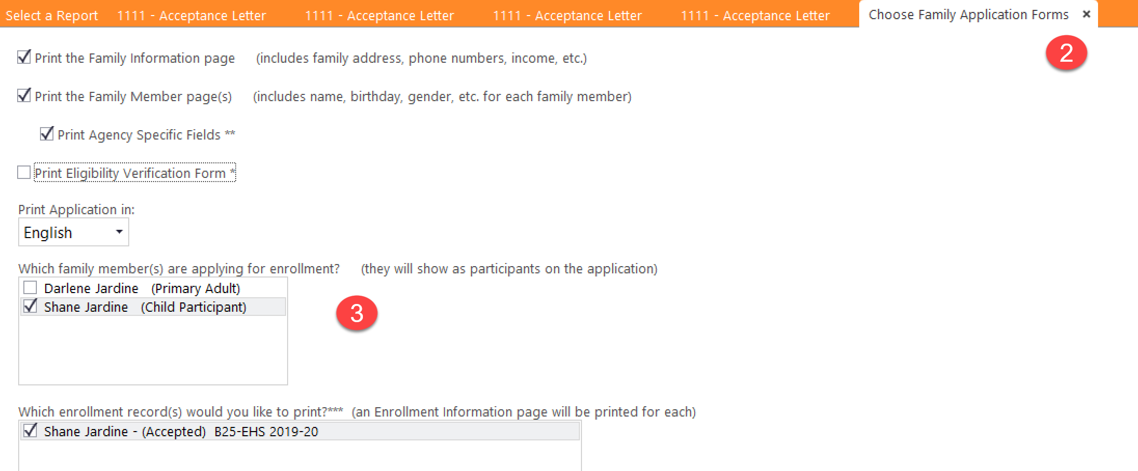
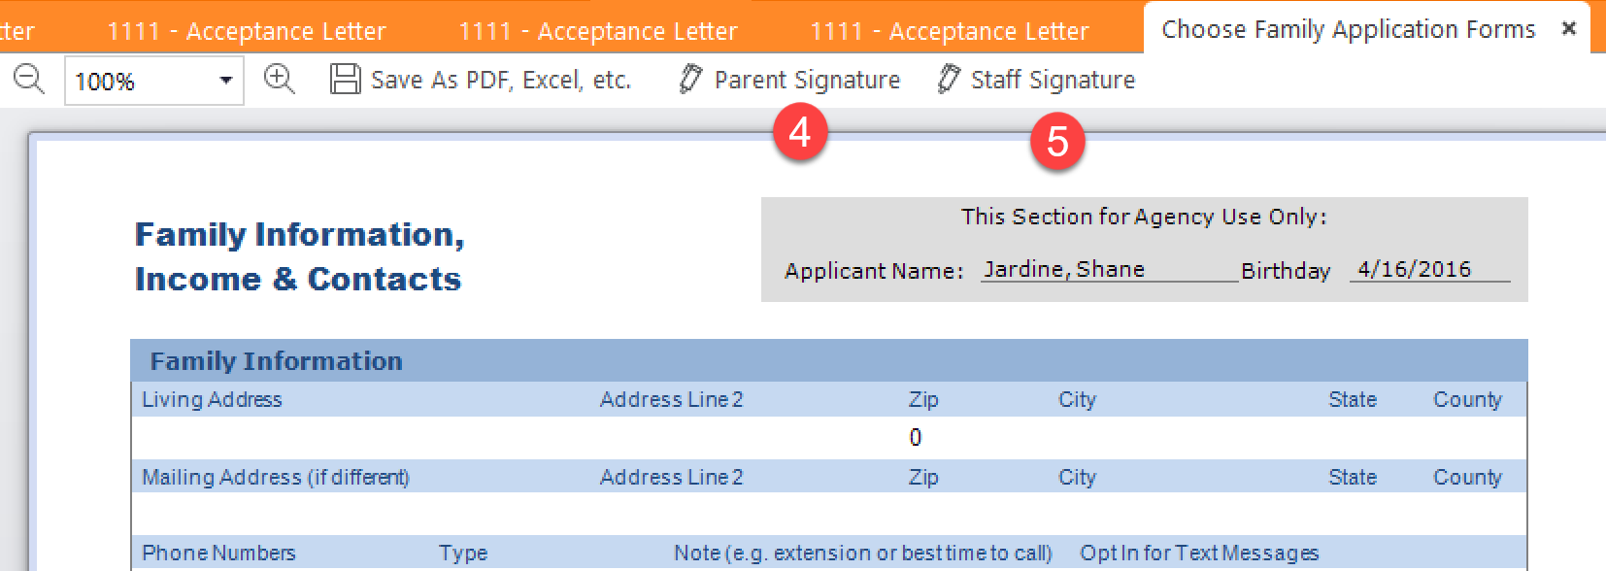
Completing application with parent and staff signatures
PAPERLESS-the vision becomes reality
Pre-fill Forms
PAPERLESS-the vision becomes reality
Direct Data input into ChildPlus
Click on Participant | “Print Application”
Click on “Choose Family App. Forms”
Click the Participant
Get Parent Signature
Staff Signature

Slide 12
PAPERLESS-the vision becomes reality
Pre-fill Forms
PAPERLESS-the vision becomes reality

Slide 13
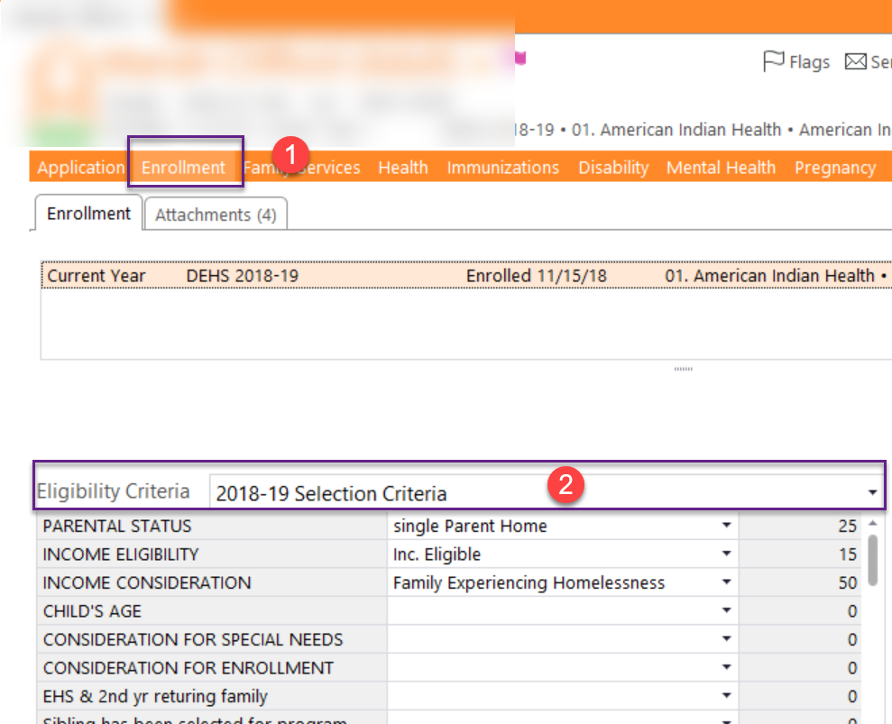
Selection Criteria
Direct data input to ChildPlus

Slide 14
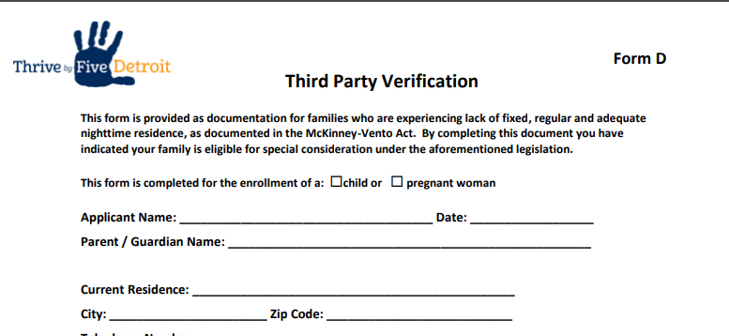
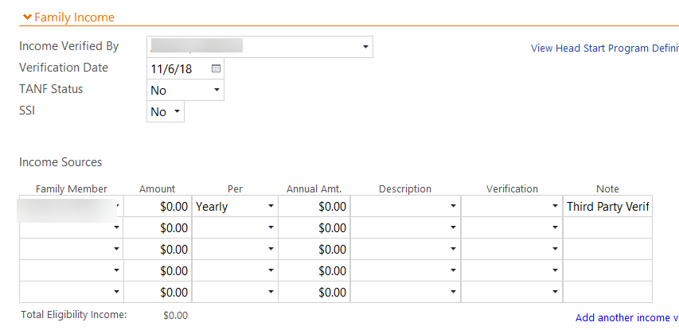
Form D
Print off the website
You need to have this only for a signature
Data input into Child Plus—Application
Data input into Child Plus—Enrollment

Slide 15
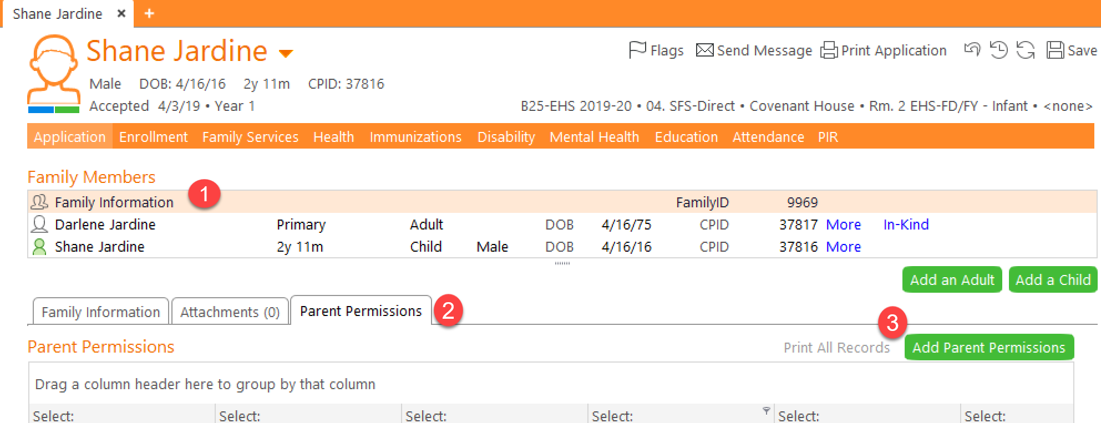
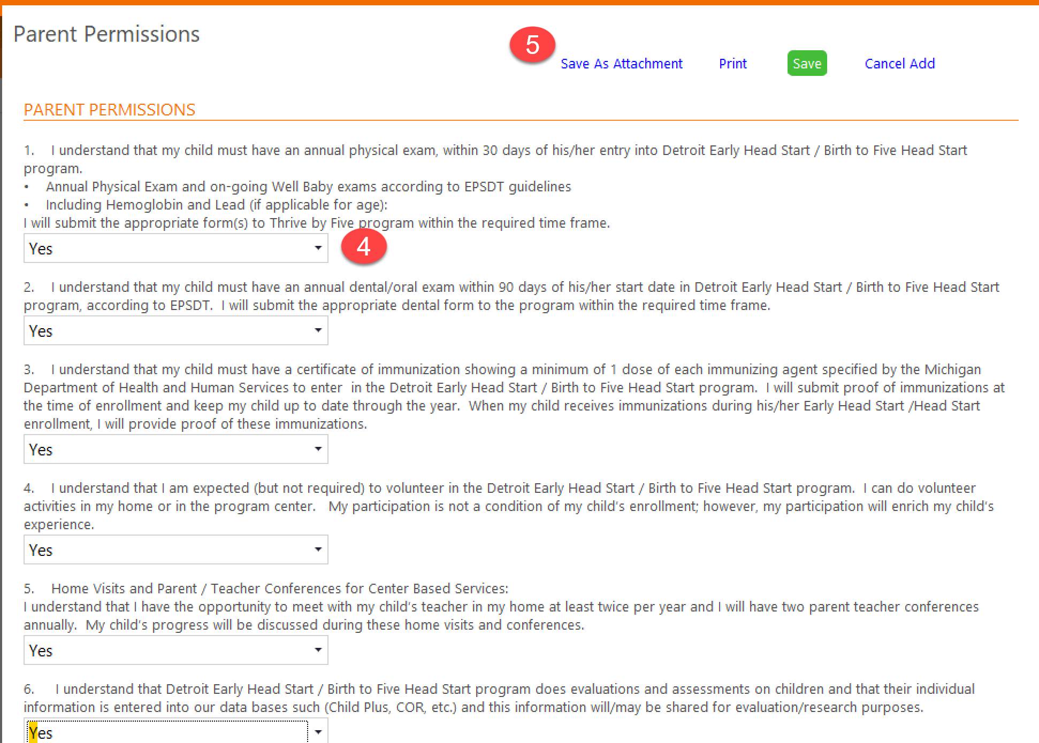
**Module-Signature-save as attachment**
Parent permissions | understanding
PAPERLESS-the vision becomes reality
**Module-Signature-save as attachment**
PAPERLESS-the vision becomes reality
Click on Application-select Family Information
Click on “”Parent Permissions”
Add Parent Permissions
Fill out applicable information and get signatures
Save as Attachment
Click on Application-select Family Information
Click on “”Parent Permissions”
Add Parent Permissions
Fill out applicable information and get signatures
Save as Attachment

Slide 16
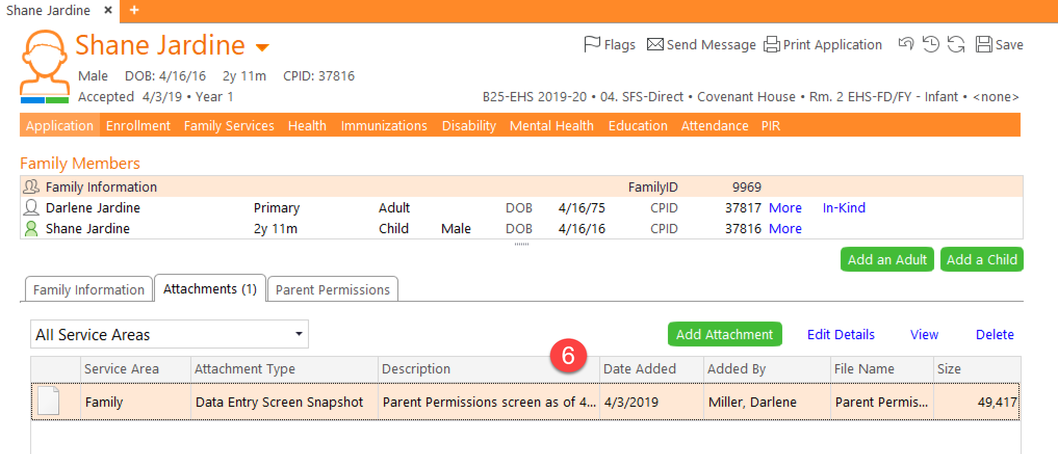
Parent permissions | understanding
PAPERLESS-the vision becomes reality
Pre-fill Forms
PAPERLESS-the vision becomes reality
6. Look under the Attachments
To get a print out of your results-always go back to your “Attachments”

Slide 17
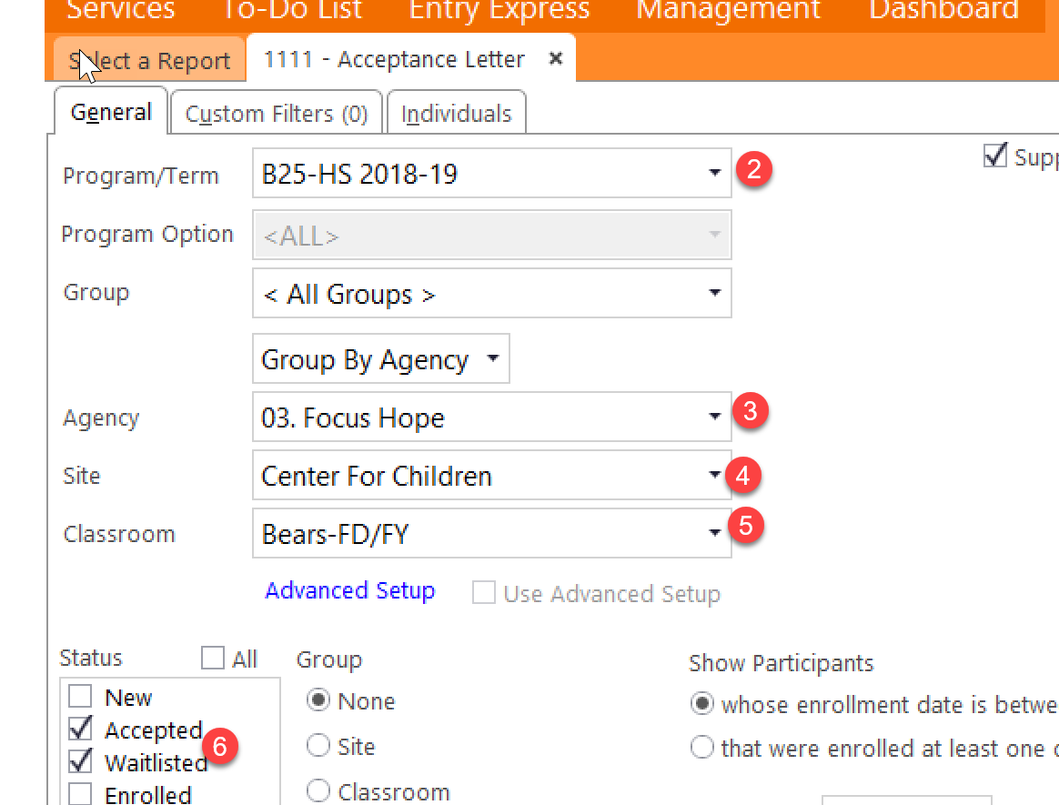
Acceptance - Email-Text How?
PAPERLESS-the vision becomes reality
Pre-fill Forms
Type in 1111
Complete all applicable fields-2-6
7. Click on individual Tab
8. Uncheck all children
9. Check on the child you are sending an acceptance email to
PAPERLESS-the vision becomes reality

Slide 18
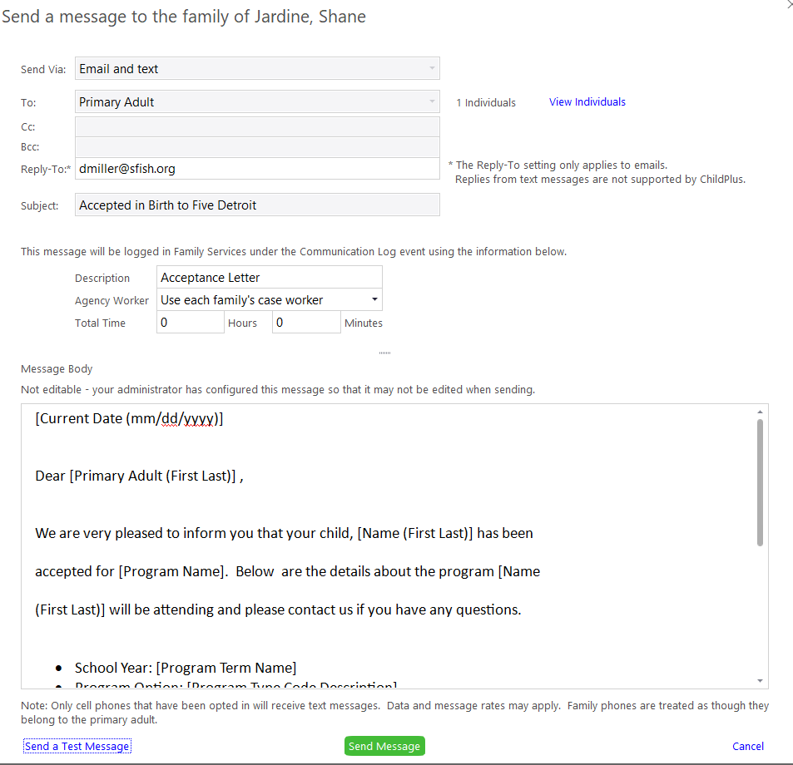
Acceptance Notice
PAPERLESS-the vision becomes reality
10.
Pre-fill Forms
PAPERLESS-the vision becomes reality
Click on Application-select Family Information
Click on “”Parent Permissions”
Add Parent Permissions
Fill out applicable information and get signatures
Save as Attachment
11.
10. Always view the individuals to make sure you have the correct child
11. Send Message
RESULTS

Slide 19
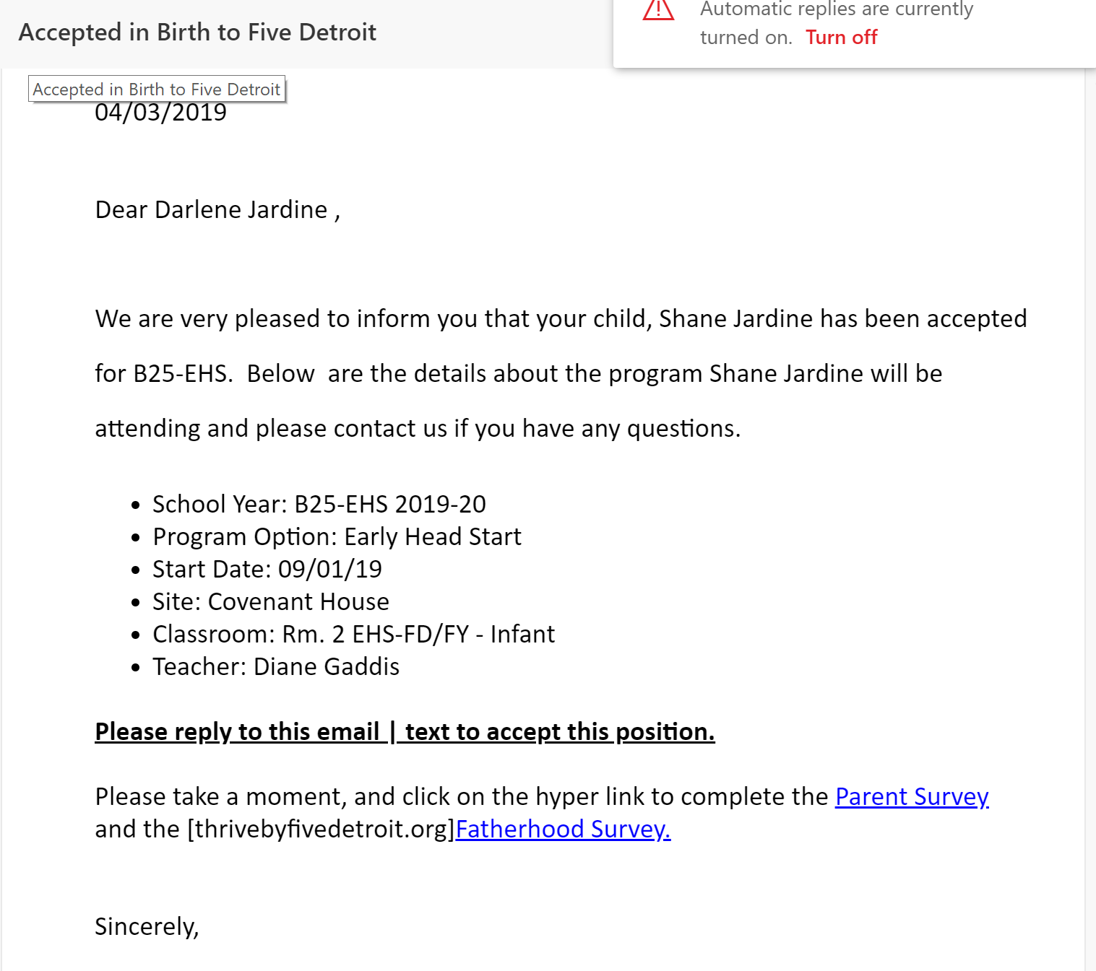
Email-Text with links to survey

Slide 20
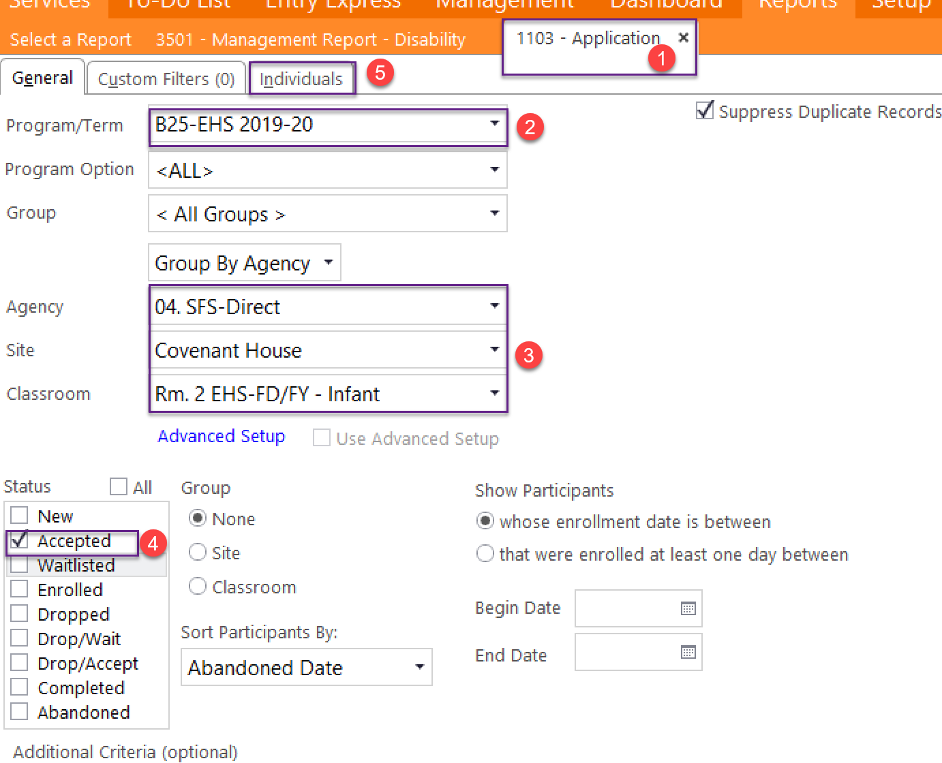
**Pre-fill Forms**
Child Information record
Type in report 1103
Click the program term
Agency, Site, Classroom
Accepted, New, Waitlisted –depending what status they are right now
Click the “Individuals” tab
Uncheck all the children and just check the child you need
Hit Preview-only print out the documents that you need
PAPERLESS-the vision becomes reality
**Module-signature-save as attachment**
PAPERLESS-the vision becomes reality
**Pre-fill Forms**
RESULTS

Slide 21
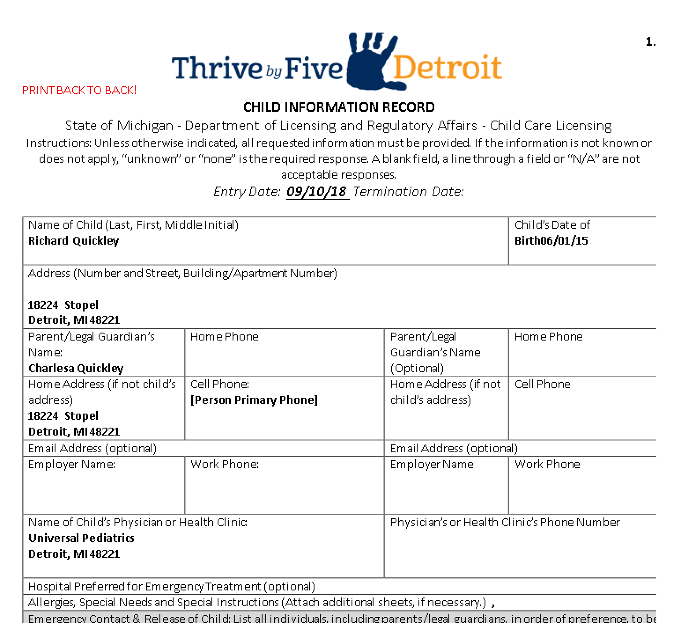
PAPERLESS-the vision becomes reality
Pre-fill Forms
Child Information record
prefilled form-RESULTS
PAPERLESS-the vision becomes reality
Print Page 1 & 2—BACK TO BACK!

Slide 22
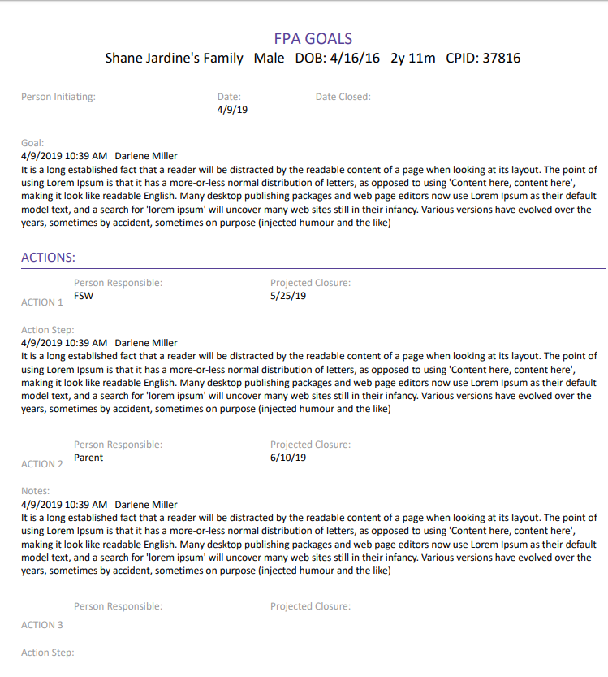
FPA Goals
1
2
4
3
5
6
7
Click on Participant
Go to the Family Service Tab
Click the FPA Goals
Click on Add FPA Goals
Complete data entry
Always save as an attachment
“result”
8
To get a print out of your results-always go back to your “Attachments”

Slide 23
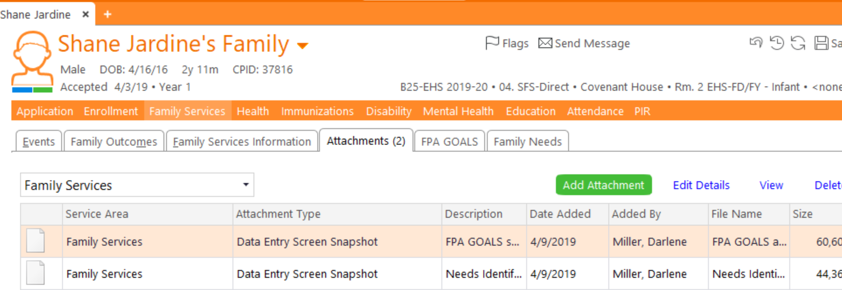
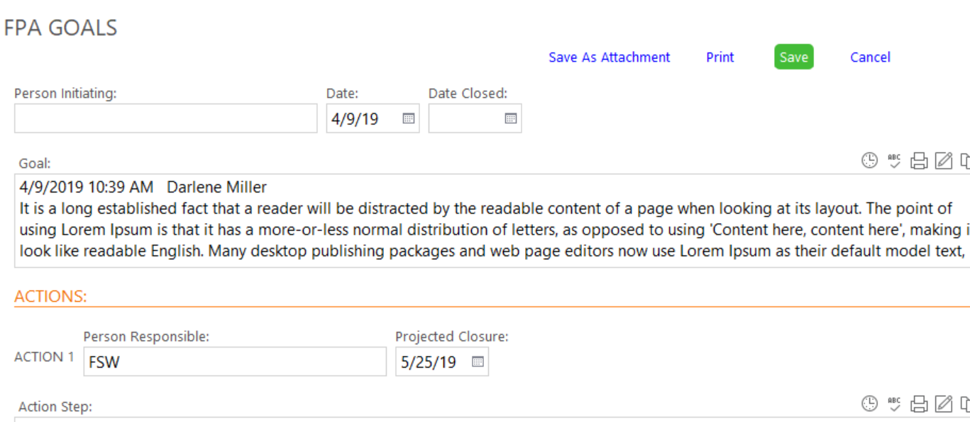
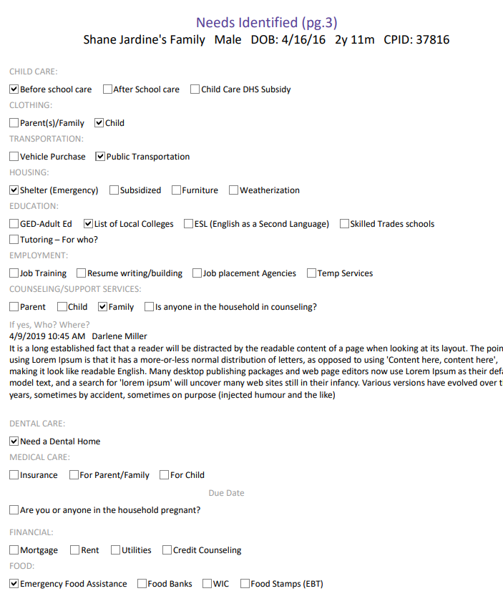
Family Needs
1
2
3
4
5
6
7
Click on Participant
Go to the Family Service Tab
Click Family Needs
Click on Add Needs Pg. 3
Complete data entry
Always save as an attachment
“result”
To get a print out of your results-always go back to your “Attachments”

Slide 24
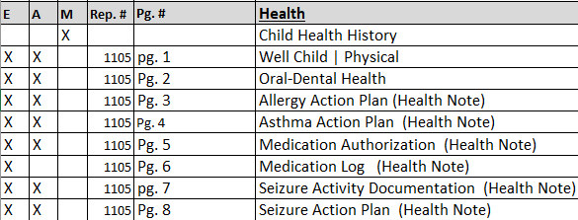
Health Modules
PAPERLESS-the vision becomes reality
Pre-fill Forms
Health History
PAPERLESS-the vision becomes reality
Click on Participant then the Health tab
Click on the “Health History” tab
Add Health History
Fill out applicable information and get signatures
Save as Attachment
To get a print out of your results-always go back to your “Attachments”

Slide 25
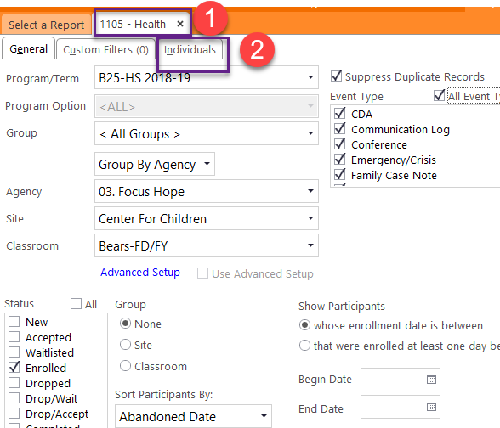
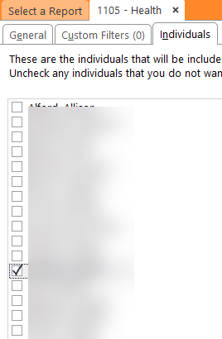
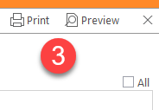
Health
Pre-filled 1105
Most Health forms reside in the Pre-filled forms
PAPERLESS-the vision becomes reality
Pre-fill Forms
PAPERLESS-the vision becomes reality
Uncheck all | Then select the child you need
In reports-type in 1105 | Fill out all applicable information
Click on the “Individuals tab”
Uncheck to de-select all children and only check the child you need a Pre-filled form for
Preview-and only type the pages you need

Slide 26
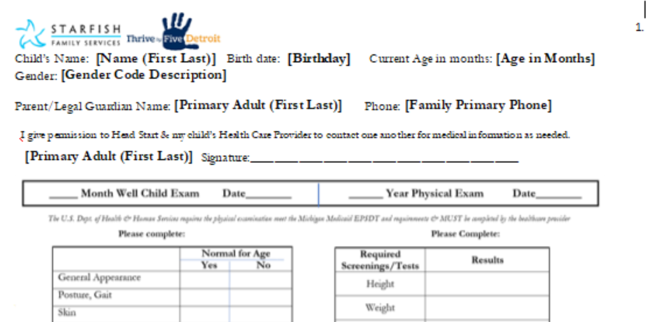
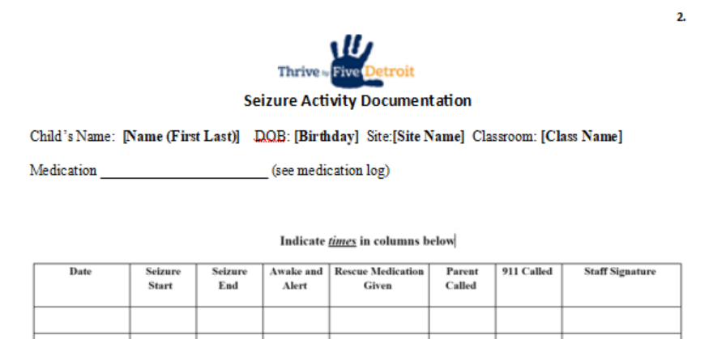
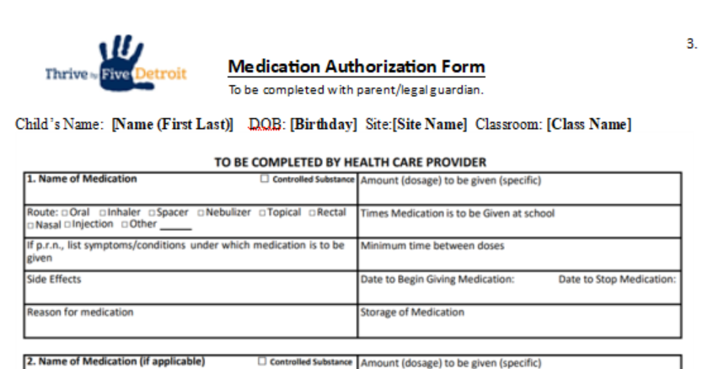
Health
Pre-filled 1105
PAPERLESS-the vision becomes reality
Physical
Pre-fill Forms
PAPERLESS-the vision becomes reality
In reports-type in 1105 | Fill out all applicable information
Click on the “Individuals tab”
Uncheck to de-select all children and only check the child you need a Pre-filled form for
Preview-and only type the pages you need
Seizure
Medication

Slide 27
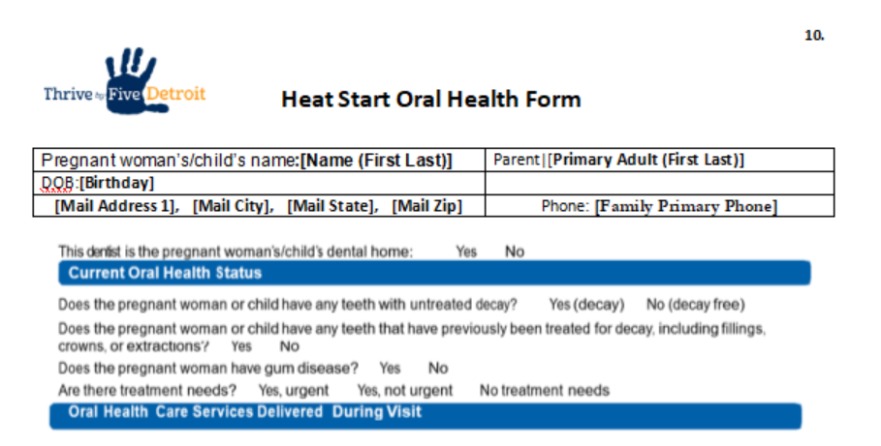
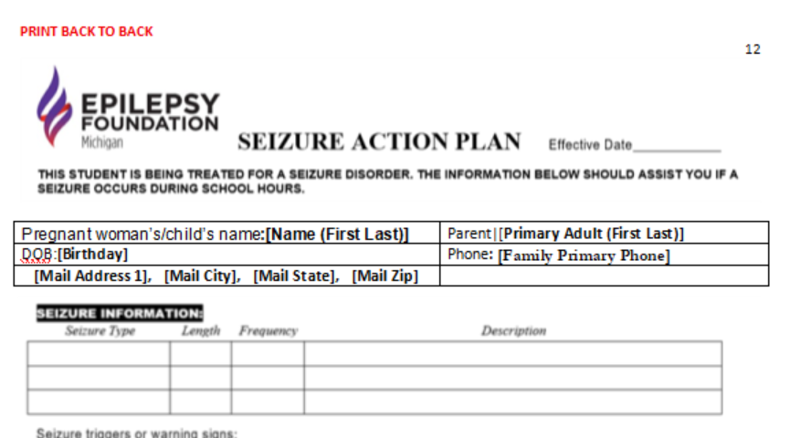
Health
Pre-filled 1105
PAPERLESS-the vision becomes reality
Oral Health Form
Pre-fill Forms
PAPERLESS-the vision becomes reality
In reports-type in 1105 | Fill out all applicable information
Click on the “Individuals tab”
Uncheck to de-select all children and only check the child you need a Pre-filled form for
Preview-and only type the pages you need
Seizure Action Plan

Slide 28
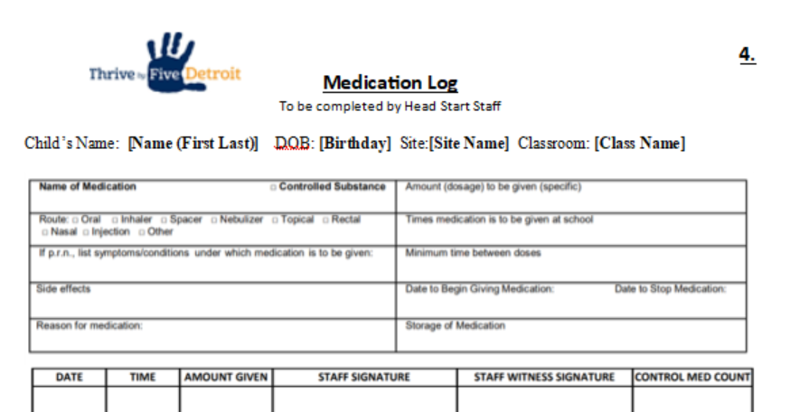
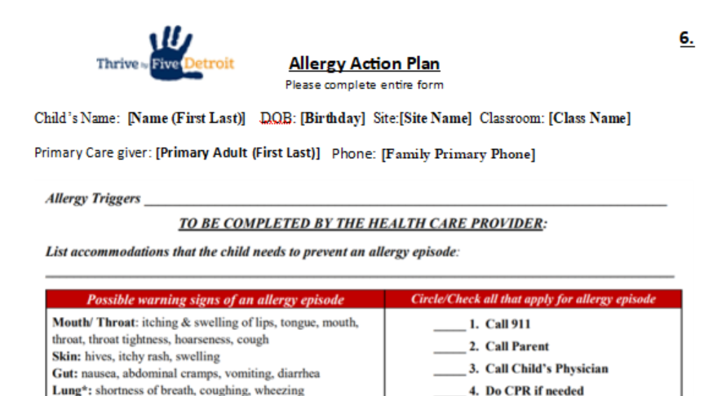
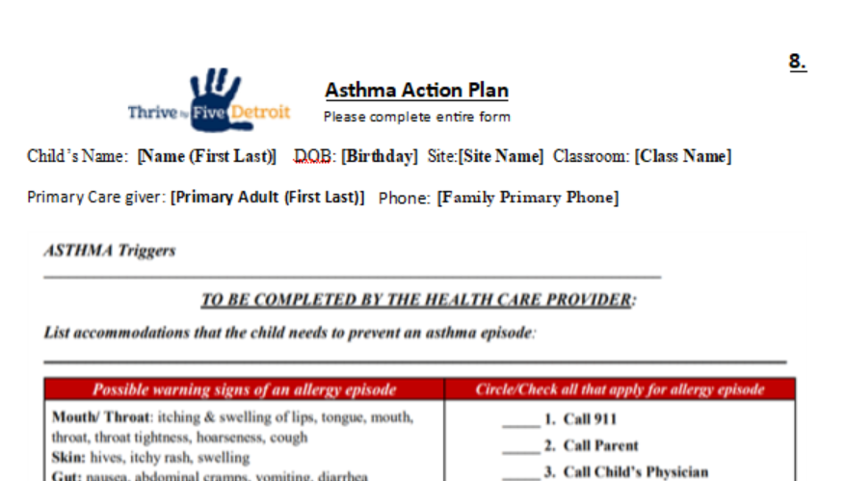
Health
Pre-filled 1105
PAPERLESS-the vision becomes reality
Medication Log
Pre-fill Forms
PAPERLESS-the vision becomes reality
In reports-type in 1105 | Fill out all applicable information
Click on the “Individuals tab”
Uncheck to de-select all children and only check the child you need a Pre-filled form for
Preview-and only type the pages you need
Allergy Action Plan
Asthma Action Plan

Slide 29
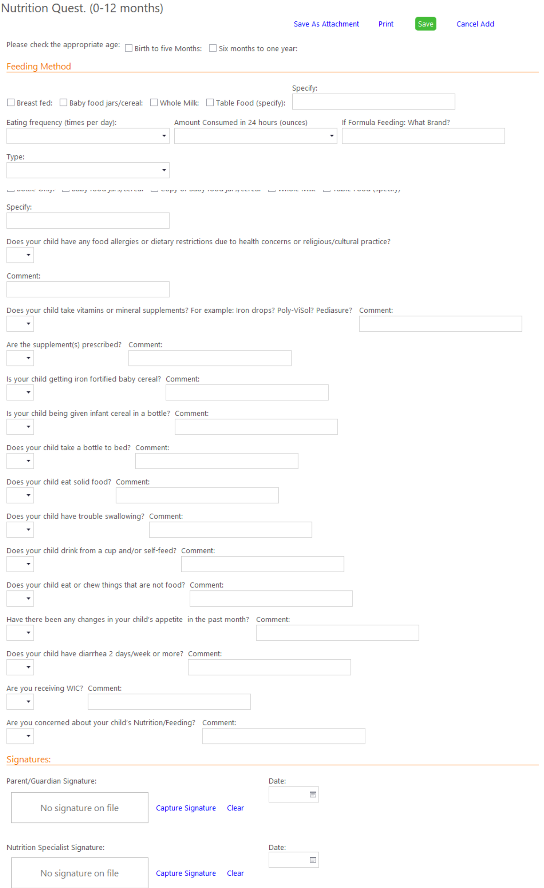
Nutrition modules
In reports-type in 1104 | Fill out all applicable information
Click on the “Individuals tab”
Uncheck to de-select all children and only check the child you need a Pre-filled form for
Preview-and only type the pages you need
To get a print out of your results-always go back to your “Attachments”

Slide 30
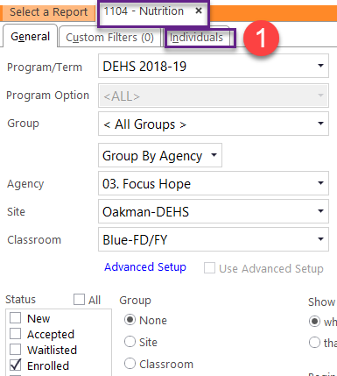
Nutrition
Reports 1104
PAPERLESS-the vision becomes reality
In reports-type in 1104 | Fill out all applicable information
Click on the “Individuals tab”
Uncheck to de-select all children and only check the child you need a Pre-filled form for
Preview-and only type the pages you need
Pre-fill Forms
PAPERLESS-the vision becomes reality
Uncheck all | Then select the child you need
To get a print out of your results-always go back to your “Attachments”

Slide 31
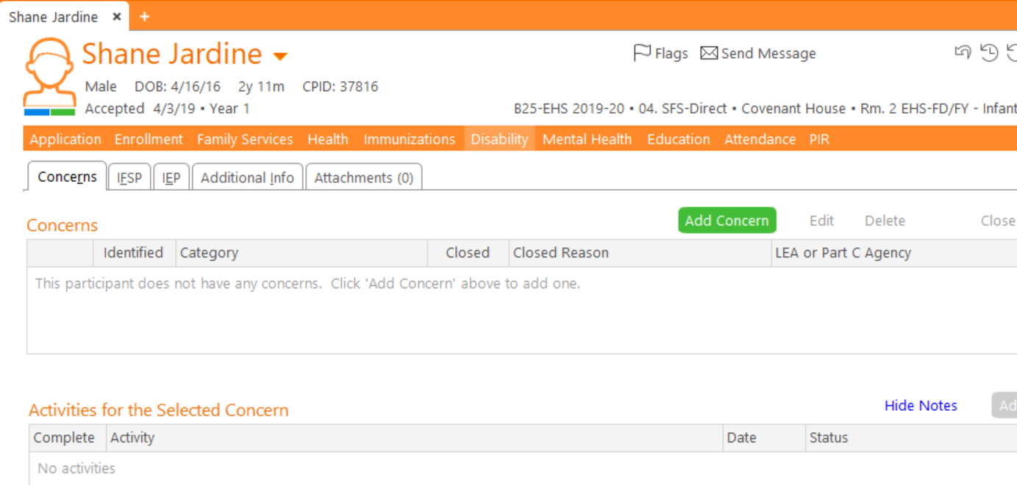
Disabilities
IEP | IFSP must be manually attached to a participant – all concerns and activities must be documented in ChildPlus
To get a print out of your results-always go back to your “Attachments”

Slide 32
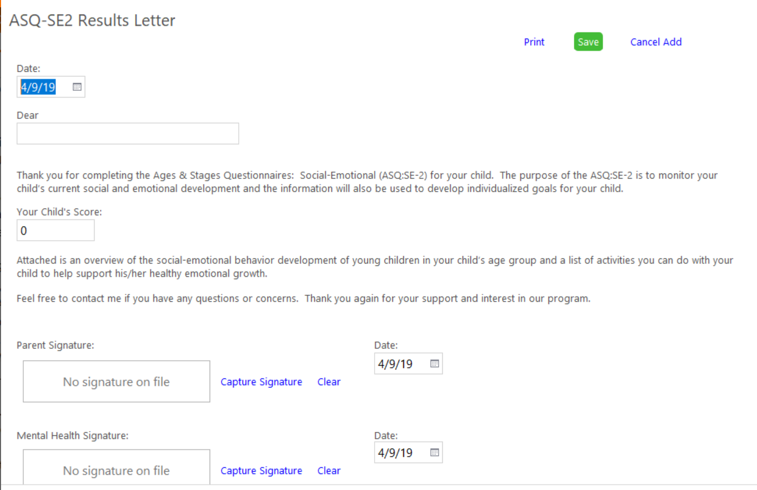
Mental Health-ASQ-SE2
1
1
2
4
3
5
Click on Participant
Go to the mental health tab
Click on the Module ASQ-SE2 Results Letter
Add ASQ-SE2 results letter
Complete data entry
Always save as an attachment
Next page is “result”
6

Slide 33
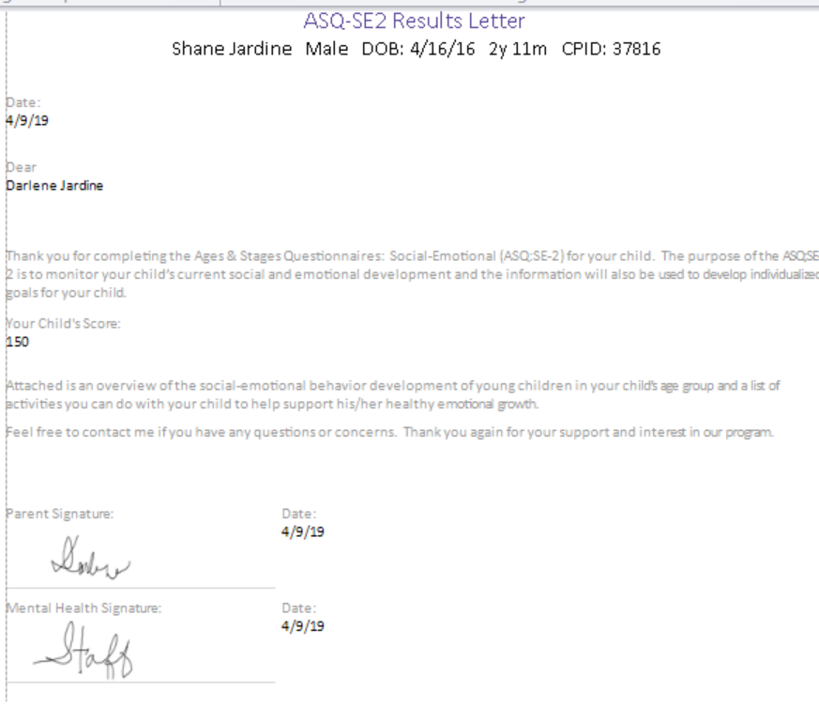
Mental Health-ASQ-SE2
6
Results Letter
To get a print out of your results-always go back to your “Attachments”

Slide 34
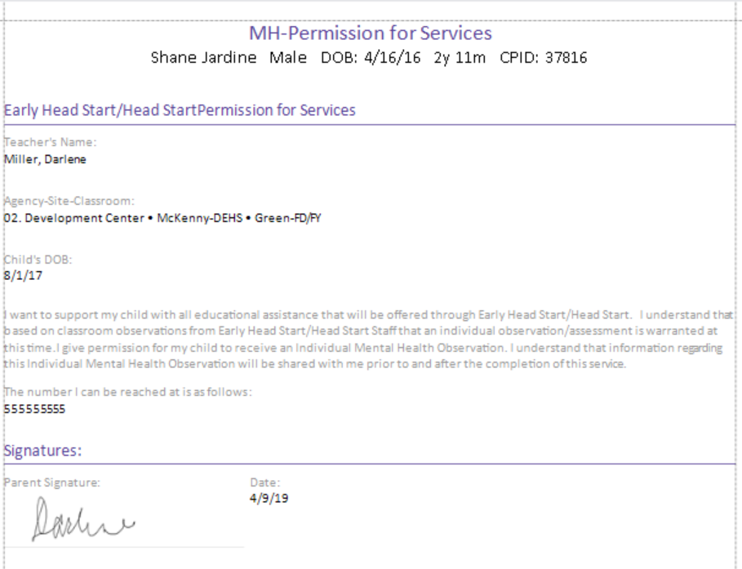
Mental Health-Permission for Services
1
2
3
4
4
6
Click on Participant
Go to the mental health tab
Click on the Module Permissions
Add Permissions for services
Complete data entry
Always save as an attachment
“result”
7
To get a print out of your results-always go back to your “Attachments”

Slide 35
Education-ASQ-Screening Results
1
2
4
3
5
6
6
Click on Participant
Go to the Education tab
Click on the Module ASQ screening results
Add Screening results
Complete data entry
Always save as an attachment
“result”
7
To get a print out of your results-always go back to your “Attachments”

Slide 36
Education
Pre-filled 1106
PAPERLESS-the vision becomes reality
HV & PTC Check list
Pre-fill Forms
PAPERLESS-the vision becomes reality
In reports-type in 1105 | Fill out all applicable information
Click on the “Individuals tab”
Uncheck to de-select all children and only check the child you need a Pre-filled form for
Preview-and only type the pages you need
ILP

Slide 37
Pregnancy-Health History
1
2
4
3
5
6
Click on Participant
Go to the Pregnancy tab
Click on Health History
Click on Add Health History
Complete data entry
Always save as an attachment
“result”
7
To get a print out of your results-always go back to your “Attachments”

Slide 38
Pregnancy-Pregnant Nutrition
1
2
3
4
5
6
Click on Participant
Go to the Pregnancy tab
Click on Health History
Click on Add Health History
Complete data entry
Always save as an attachment
“result”
7
To get a print out of your results-always go back to your “Attachments”

Slide 39
Pregnancy-Prenatal Exam Form
**Pre-fill Forms # 1108**
1
4
2
3
6
Click on Participant
Go to the Pregnancy tab
Click on Health History
Click on Add Health History
Complete data entry
Always save as an attachment
“result”
5
7
To get a print out of your results-always go back to your “Attachments”

Slide 40
Pregnancy-post
1
2
3
4
Fill out Health History – and
5
6
Click on Participant
Go to the Pregnancy tab
Click on Post-New Checklist
Click on Add Post-New checklist
Complete data entry
Always save as an attachment
“result”
7
To get a print out of your results-always go back to your “Attachments”
To get a print out of your results-always go back to your “Attachments”

Slide 41
Pre-filled Forms-ALL PRE-FILLED FORMS WORK THE SAME WAY
1
Type in the # of report needed
Example if you put in 1105 all the Pre-filled forms for Health will appear-only print out what you need.
3
2
Type in the Report #
Fill out all applicable information
Click on the individual tab
Un-check all except for the one child
Preview
4
4

Slide 42
Pre-filled Forms-RESULTS
**Only print out what you need – for example you only need the Infant Nutrition Questionnaire (Birth – 12 months (note at the top it is page #3

Slide 43
Attendance Plan
1
3
2
4
5
6
Click on Participant
Go to the Attendance tab
Click on the Attendance Partnership Plan
Add Attendance Plan
Complete data entry
Always save as an attachment
“result”
7
To get a print out of your results-always go back to your “Attachments”

Slide 44
7
Results

