Slide 1
Welcome to the 2017-18 Program Metrics
It’s going to take a Team

Slide 2
PROGRAM METICS
METRICS! Is data that represents key indicators processes that organizations track and monitor to assess the state of the company.

Slide 3
Grantee will develop performance metrics
Build a stronger-viable database to measure outcomes for our children and families
Share data appropriately with different audiences and show how each audience can use the information
Embrace that data opens doors for staff to become more knowledgeable
Delegate will continually update data into Child Plus
Use your program's data to decide on new priorities
Celebrate the good news that data shows and learn from the bad news so you can improve your program
Understand how the data is collected
Establishing critical processes/client requirements
Establishing targets—indicators against which results can be scored
Identifying specific, measurable outputs of work
Metrics: Measuring what matters
Metrics and Impact

Slide 4
COR
ERSEA
EDUCATION
Referrals
HEALTH
DISABILITIES
Family Community Partnership
MENTAL HEALTH

Slide 5
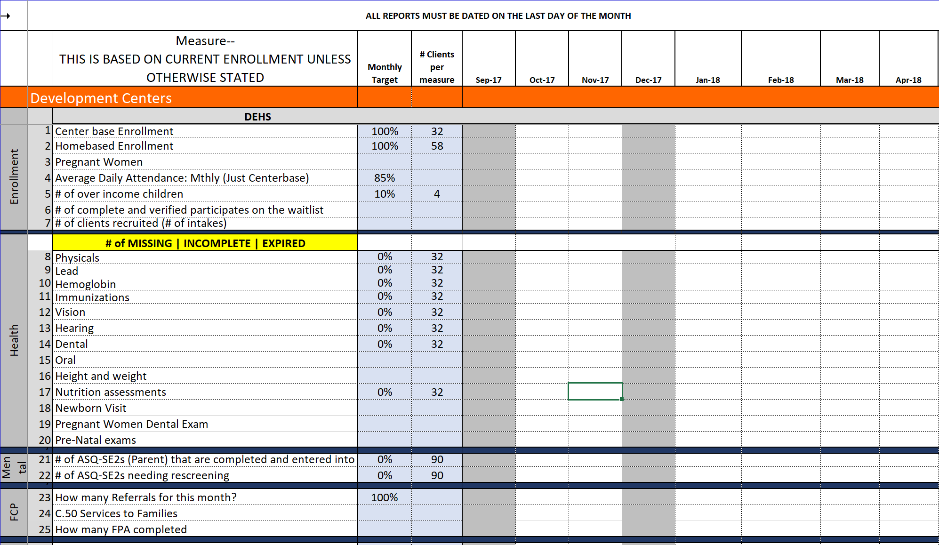
Introducing the Program Metrics

Slide 6
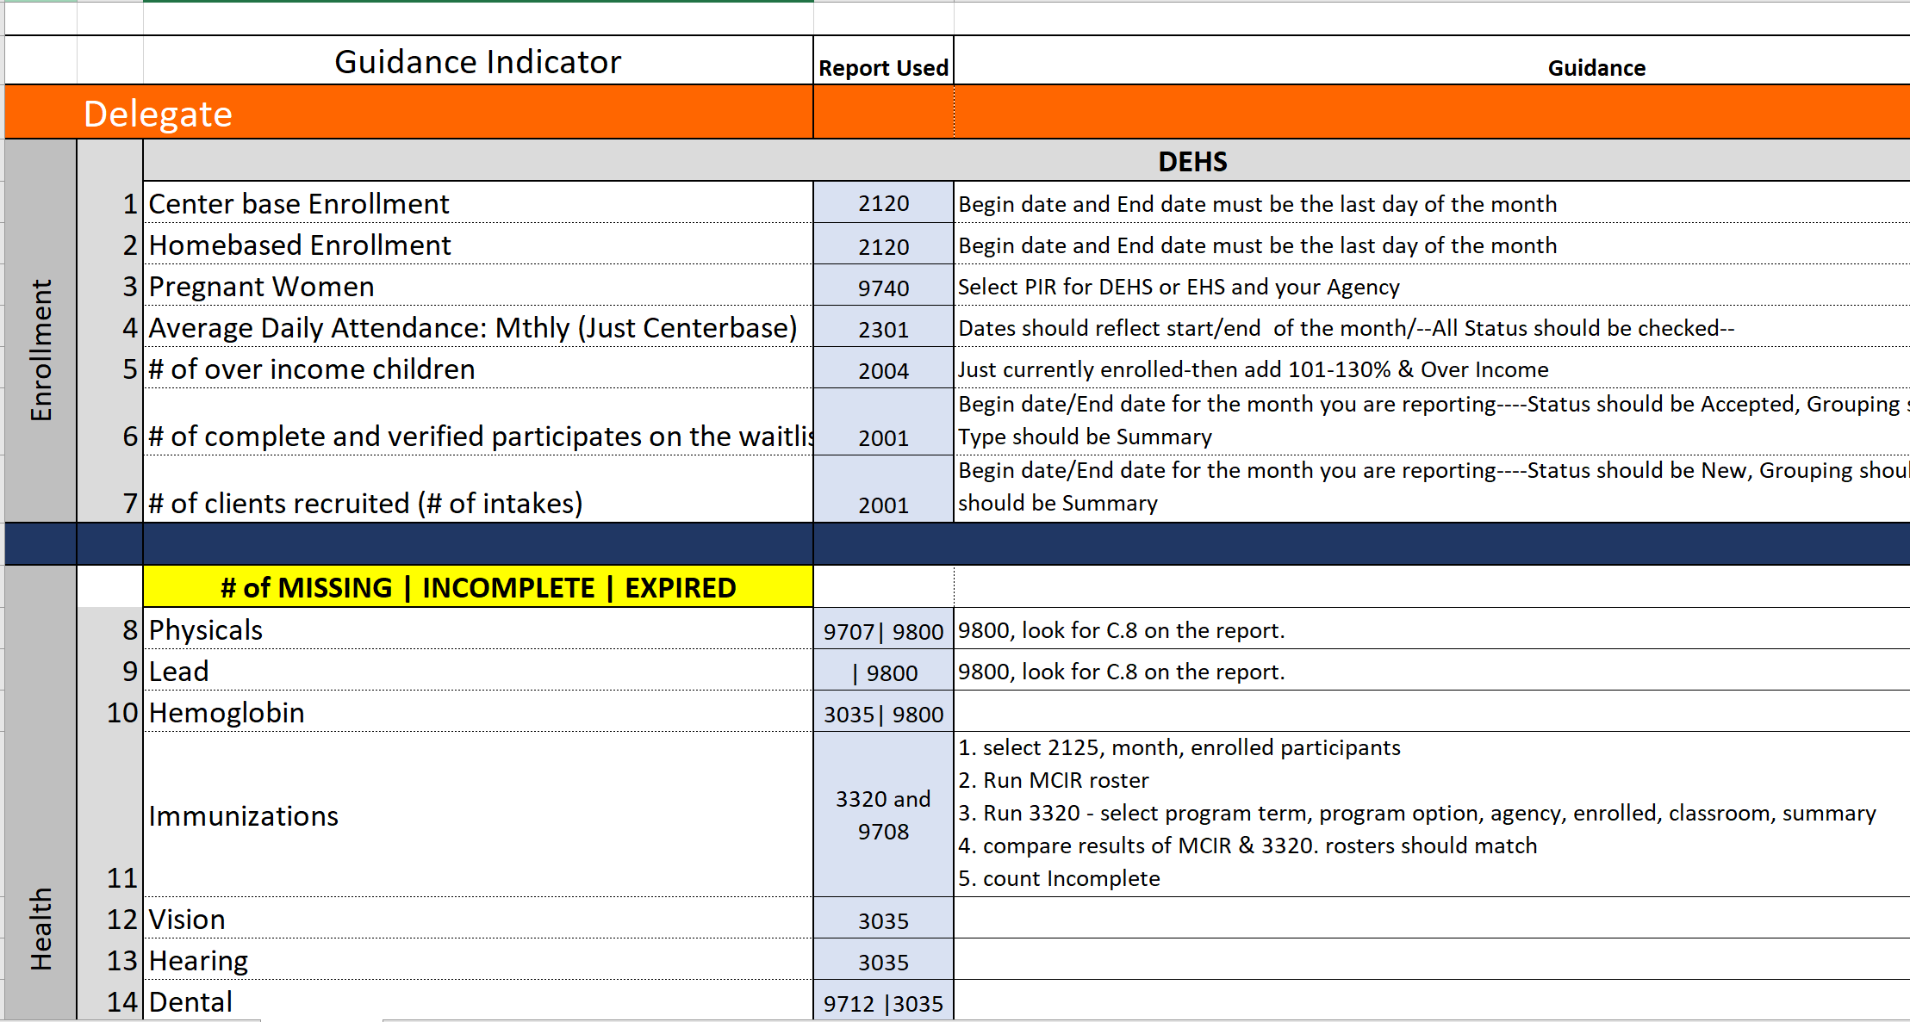
Guidance

Slide 7
met·rics- definition
a method of measuring something, or the results obtained from this.
"the report provides various metrics at the class and method level"
GRANTEE
ANALYZE DELEGATE DATA AND CREATE A MONITORING METRIC RESULT IN CHILD PLUS BY THE END OF THE 2ND WEEK OF THE MONTH
DELEGATE
ARE TO CREATE A CAP FOR EVERY NON-COMPLIANCE BY THE END OF THE 3RD WEEK OF THE MONTH
2^{ND WEEK}
3RD WEEK
DELEGATE
TO HAVE ALL DATA ELEMENTS IN BY THE 1ST WEEK OF THE MONTH
GRANTEE WILL VERIFY CAP IS IN PLACE & FOLLOW UP UNTIL RESOLVED
1^{ST WEEK}
4TH WEEK
DELEGATE| GRANTEE ROLES

Slide 8
Why do we monitor?
Methods of Ongoing Monitoring
Program Metrics Reporting
Desk Audits
Field Observations
Self Assessment
Ongoing Monitoring

Slide 9
Analyze
FAIR
Could we use improvement
from here on out.

Slide 10
Analyze and Improve
GOOD JOB!
GOOD START TO THE TOP! We are getting to the BEST.

Slide 11
Analyze and keep analyzing
BETTER, NICE JOB!
We are getting there

Slide 12
We have the BEST services for our children and families to succeed
BEST EVER! With hard word and looking at the metrics constantly we are here!

Slide 13
We want to be able to provide the best services for our children and families
BEST

