Slide 1
Monitoring, Metrics & F.A.C.T
The Road to Quality
Presented by:
Darlene Miller-Data Manager

Slide 2
Monthly
Program Metrics
Metrics
Monitoring

Slide 3
METRICS: MEASURING WHAT MATTERS
Metrics and Impact
Grantee Responsibility
Delegate Responsibility
Assessing Viable Data
Grantee will develop performance metrics 1. Establishing critical processes/client requirements 2. Identifying specific, quantifiable outputs of work 3. Establishing targets —indicators against which results can be scored | Delegate will continually update data into Child Plus 1. Understand how the data collected 2. Use your program's data to decide on new priorities 3. Celebrate the good news that data shows and learn from the bad news so you can improve your program | Build a stronger-viable database to measure outcomes for our children and families Share data appropriately with different audiences and show how each audience can use the information Embrace that data opens doors for staff to become more knowledgeable

Slide 6
Program metric
TIMELINE
GRANTEE
WILL ANALYZE DELEGATE DATA AND CREATE A MONITORING METRIC RESULT IN CHILD PLUS BY THE END OF THE 2ND WEEK OF THE MONTH
DELEGATE
WILL CREATE A CAP FOR EVERY NON-COMPLIANCE DURING THE END OF THE 3RD WEEK OF THE MONTH
2^{ND WEEK}
3RD WEEK
DELEGATE
WILL HAVE ALL DATA ELEMENTS IN DURING THE 1ST WEEK OF THE MONTH
GRANTEE WILL VERIFY CAP IS IN PLACE & FOLLOW UP UNTIL RESOLVED
1^{ST WEEK}
4TH WEEK
DELEGATE| GRANTEE ROLES
The metrics report will provide a “real time” month to date dashboard of important program indicators

Slide 7
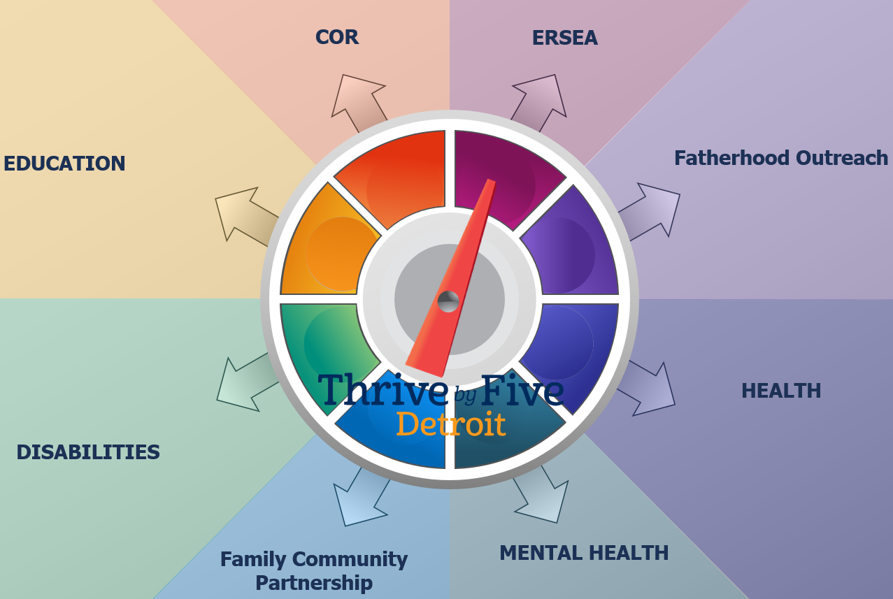
Macro level indicators

Slide 8
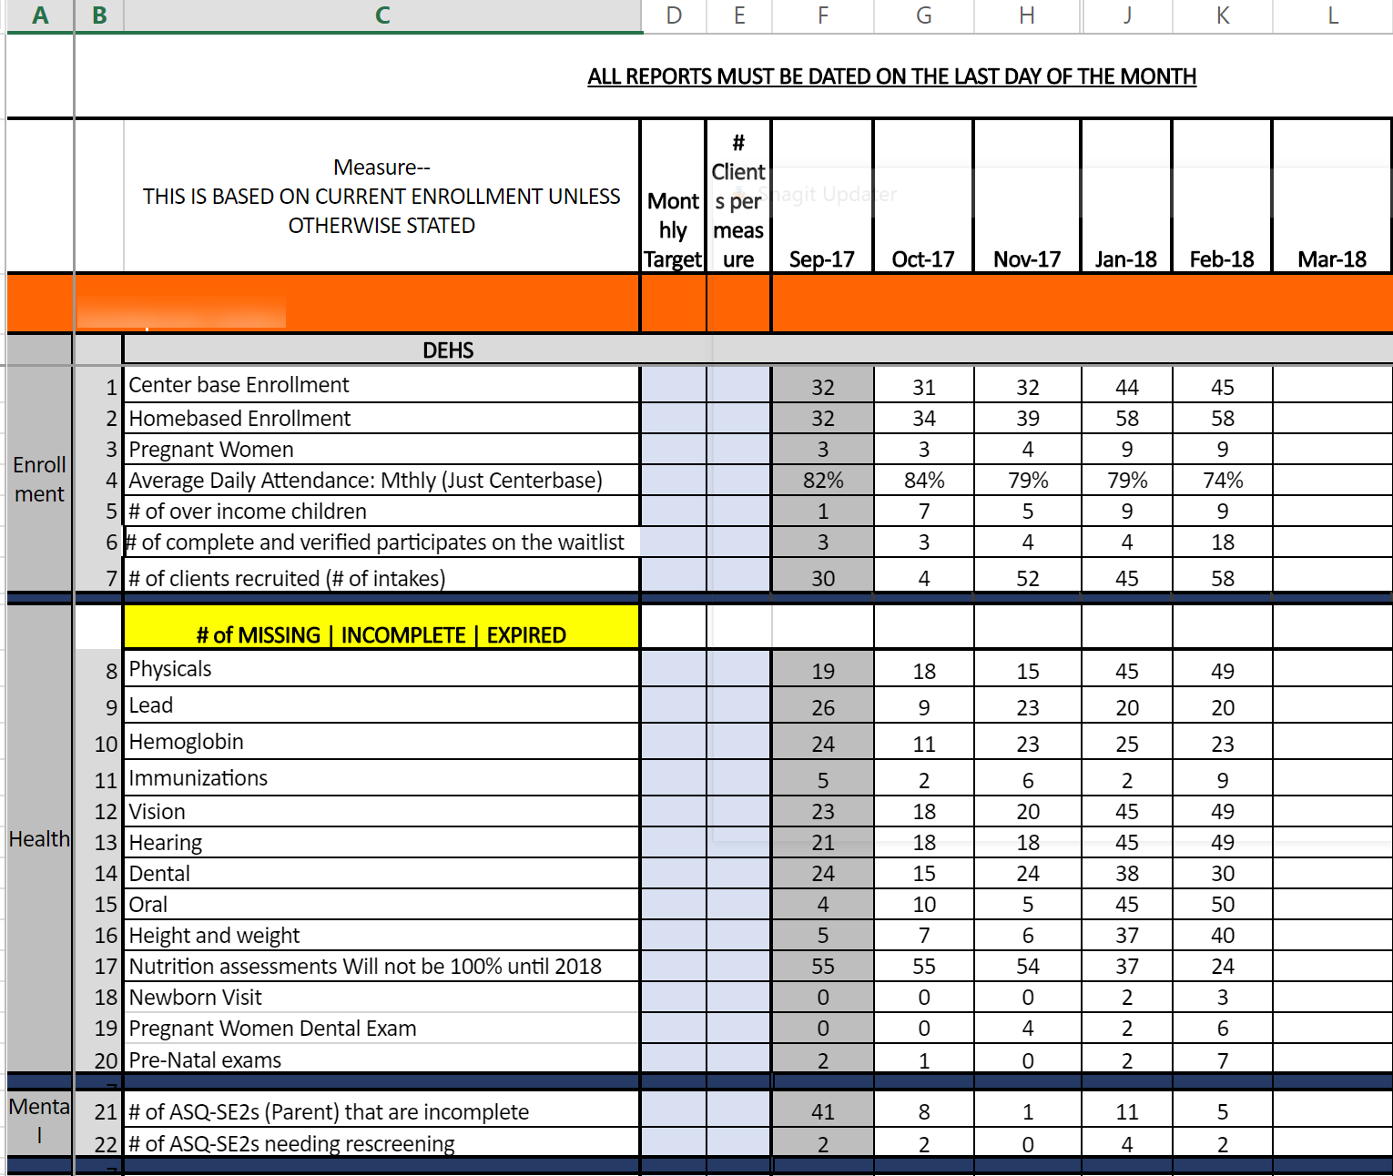
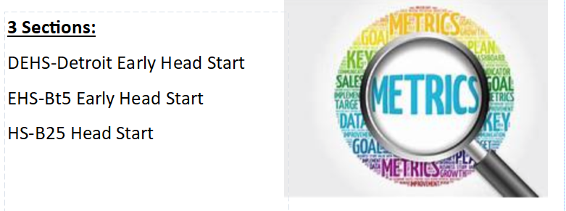
Micro level indicators

Slide 9
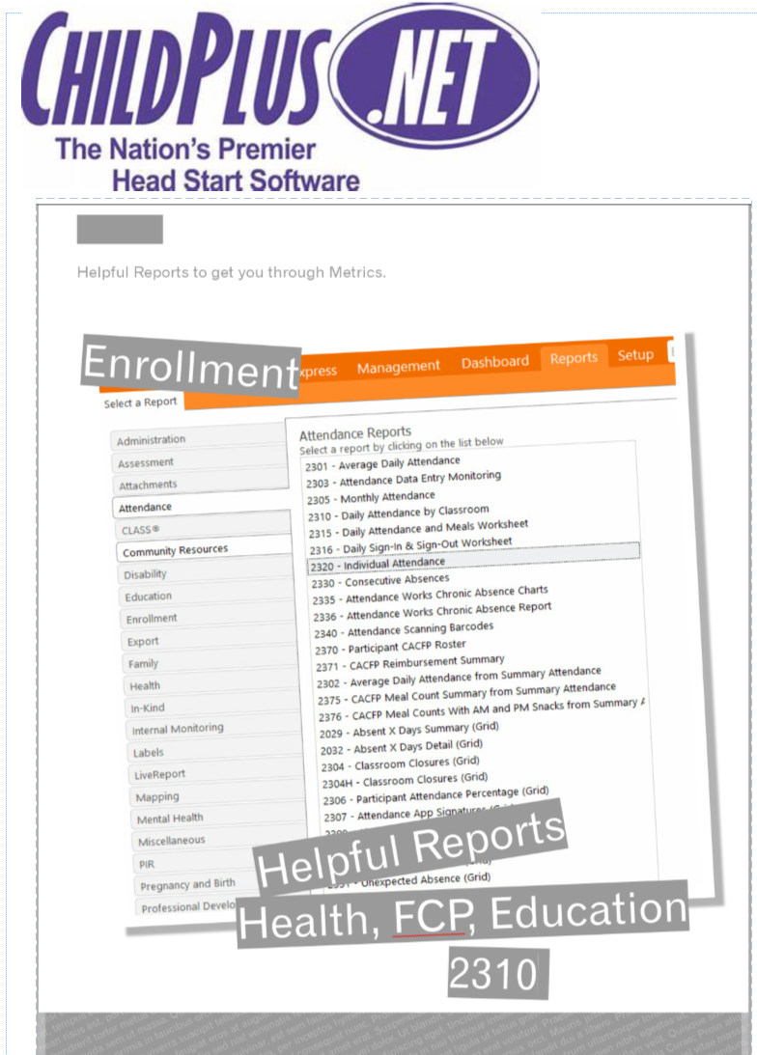

Slide 11
Video

Slide 12
Do you ever feel like this when you think of monitoring?

Slide 13
Monitoring and Data is everyone’s business…
Grantee
Delegate
Specialists
Volunteers
Admin. Assistant
Custodians
Parents
FSW’s
Teachers
Home Visitors
Notes:
1. Monitoring and Data is everyone’s business-
2. however the issue is that if the data is not put in your database correctly and monitored thoroughly your data will be grossly incorrect and decisions will be made based on incorrect data
3. Remember 20 years ago-we made decisions based on data collected on spreadsheets-(hmmm some of you are still doing that)
4. We have the technically to really dive into to some great data – but we must value monitoring and data-train your staff
3. it should be transparent to all—

Slide 14
Grantee On-Going Monitoring Process
Child Plus
Program Metrics
F.A.C.T
(Family & Child Tracking)
File Audits
Desk Audit
Self Assessment
Field Monitoring

Slide 15
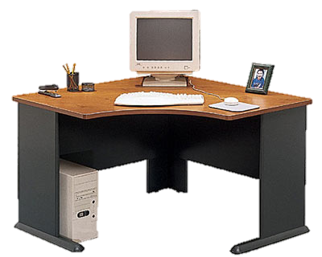
Grantee Desk Audits
Desk
Audits

Slide 16
Desk Auditing
Delegates will do self-monitoring.
Create your own system for Desk Auditing
Follow-up and correct any non-compliances within time-frame.
Grantee designated content specialist will do Desk Auditing.
Grantee Team members will monitor utilizing Child Plus.
Grantee will create monitoring results and Delegates will develop a CAP based on non-compliances if needed.
Monitoring Manager will follow-up with Delegate in agreed time frame.

Slide 17
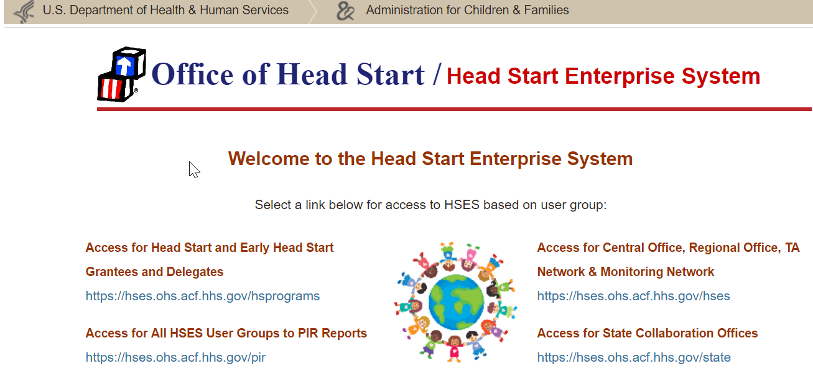
Monthly
P.I.R.
Dashboard

Slide 18
Field Observations
Qtrly
Health

Slide 19
Field Auditing
Delegates will do self-monitoring.
Create your own tool to monitor
Follow-up and correct any non-compliances within time-frame.
Grantee designated content specialist will do onsite monitoring.
Grantee Team members will monitor utilizing policies and performance standards.
Grantee will create monitoring results and Delegates will develop a CAP based on non-compliances if needed.
Monitoring Manager will follow-up with Delegate in agreed time frame.

Slide 20
Self Assessment
Annual

Slide 22
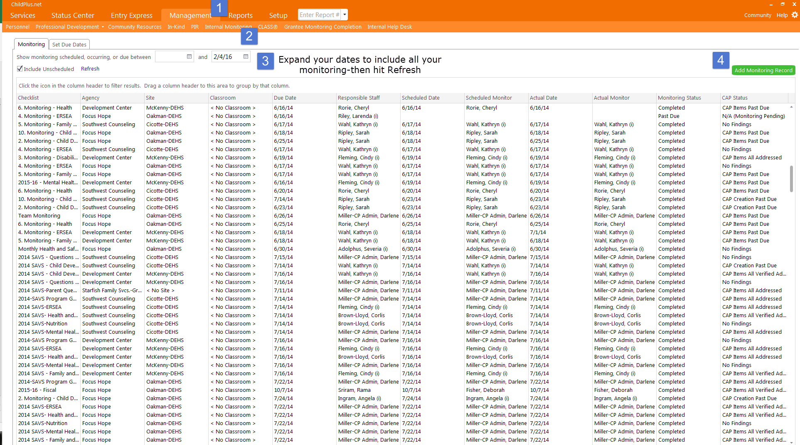
To Add a New Monitoring Session

Slide 24
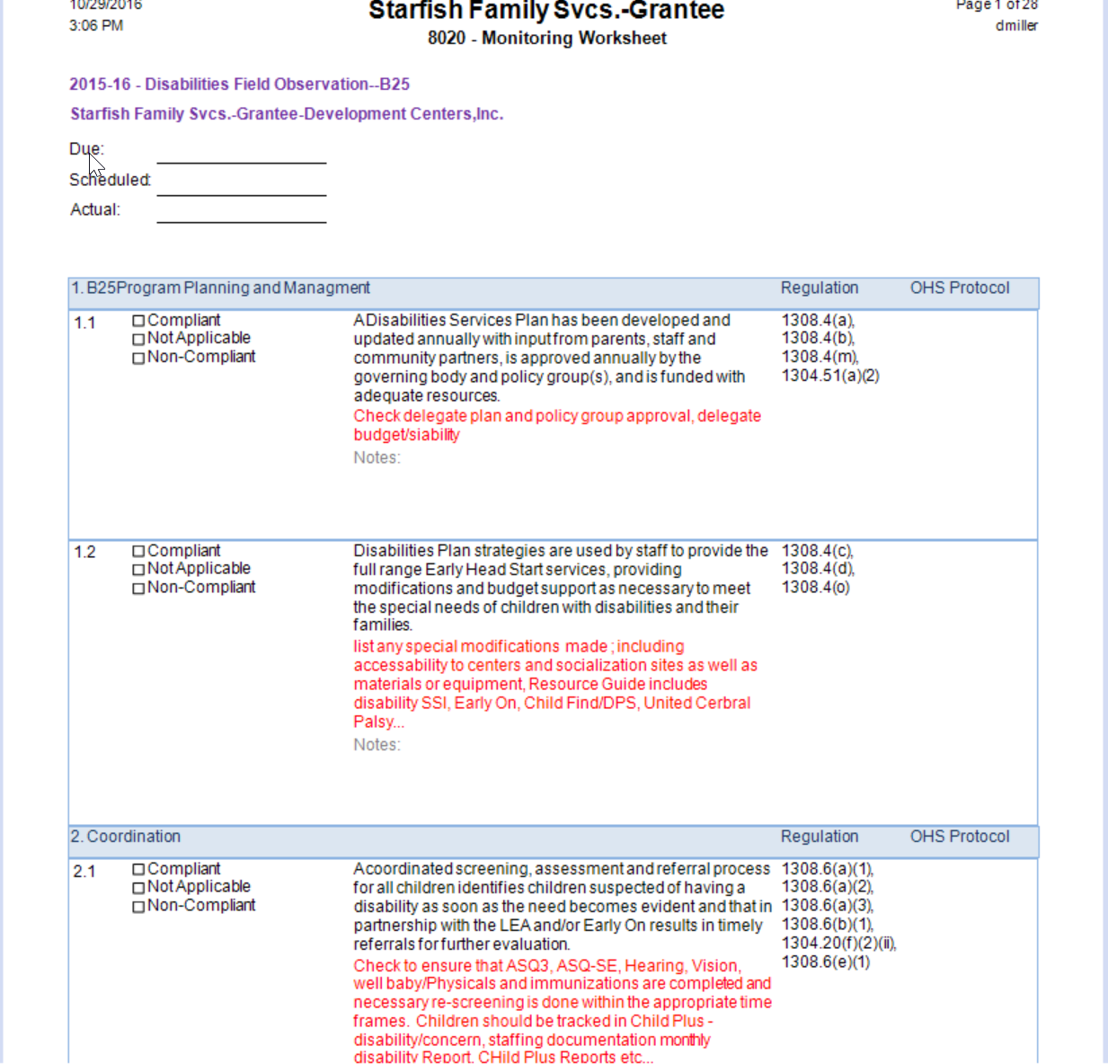
Indicator
Guidance

Slide 25
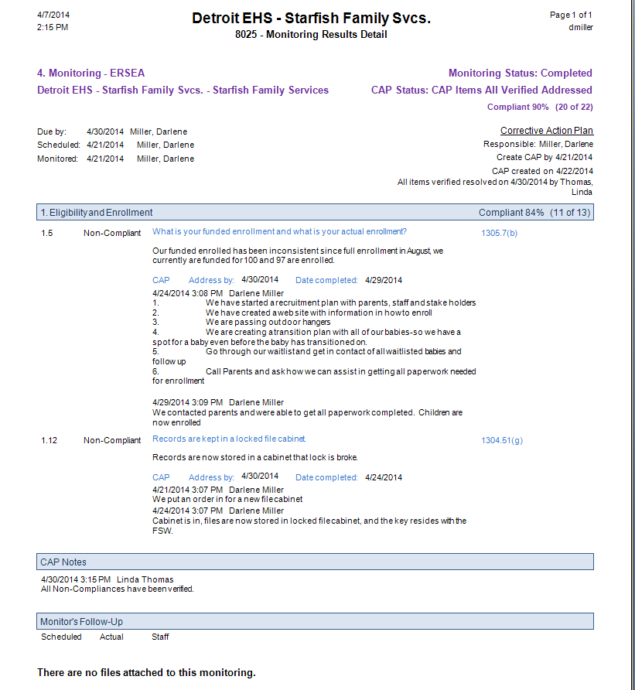

Slide 26
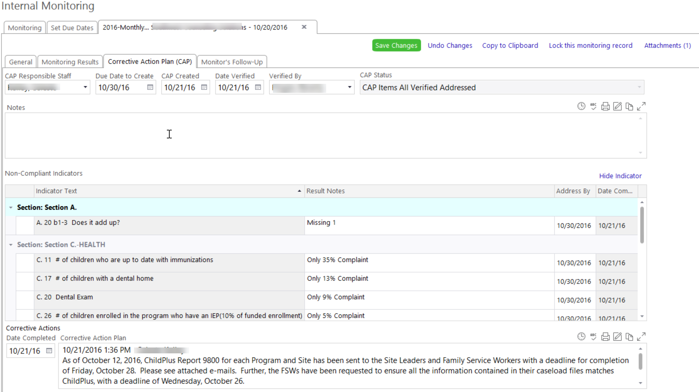

Slide 27
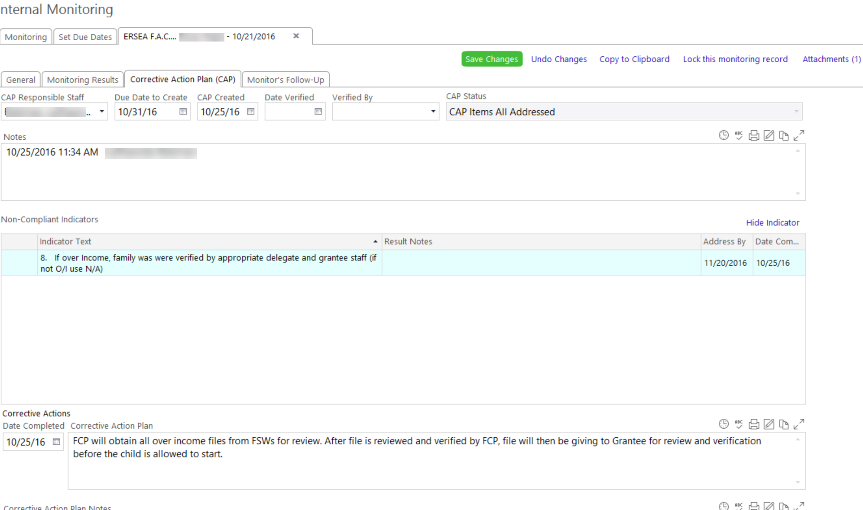

Slide 28
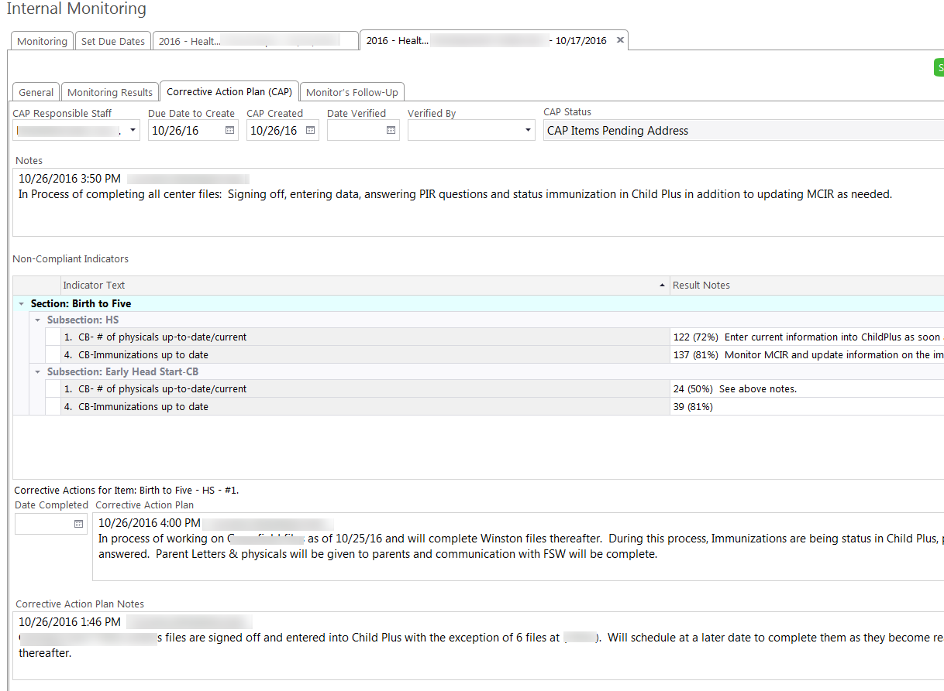

Slide 29
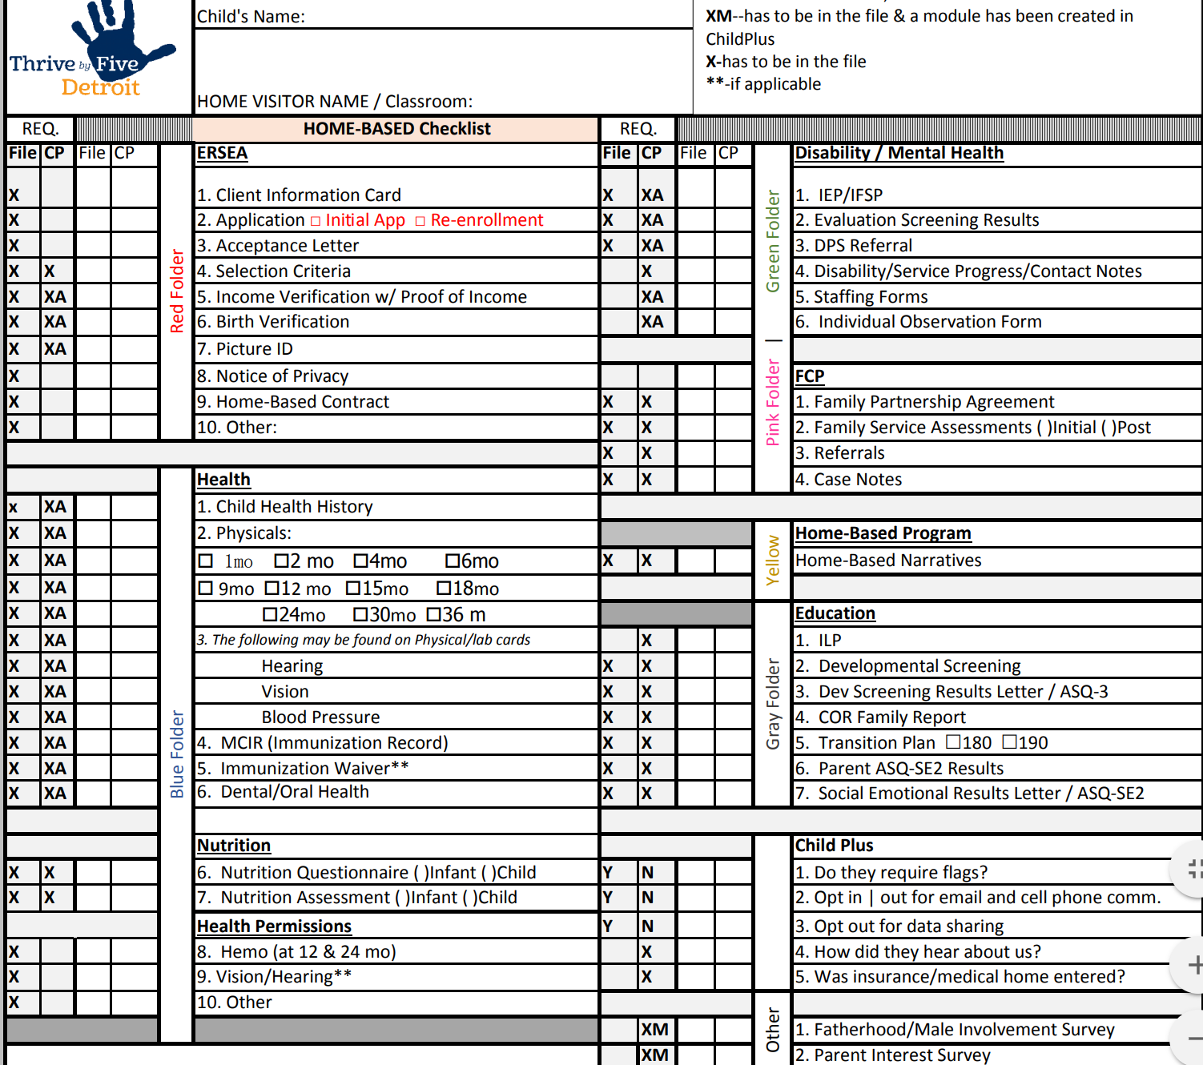
HB File Checklist

Slide 30
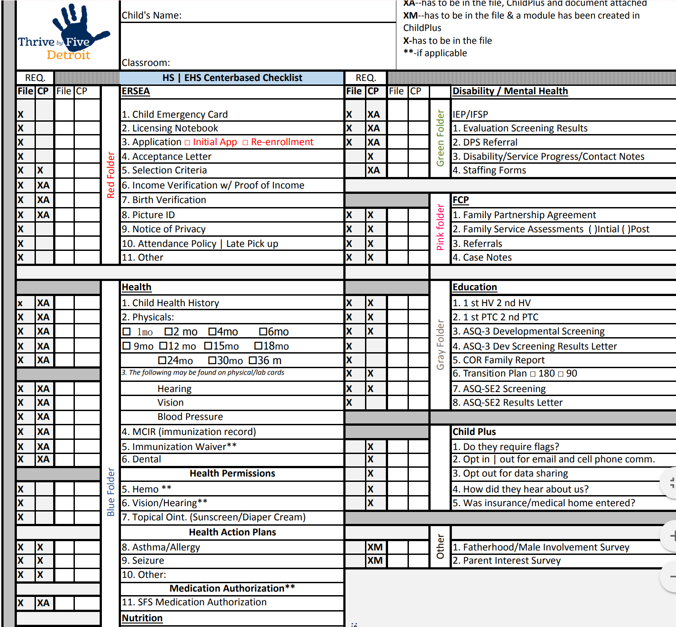
HS File Checklist

Slide 31
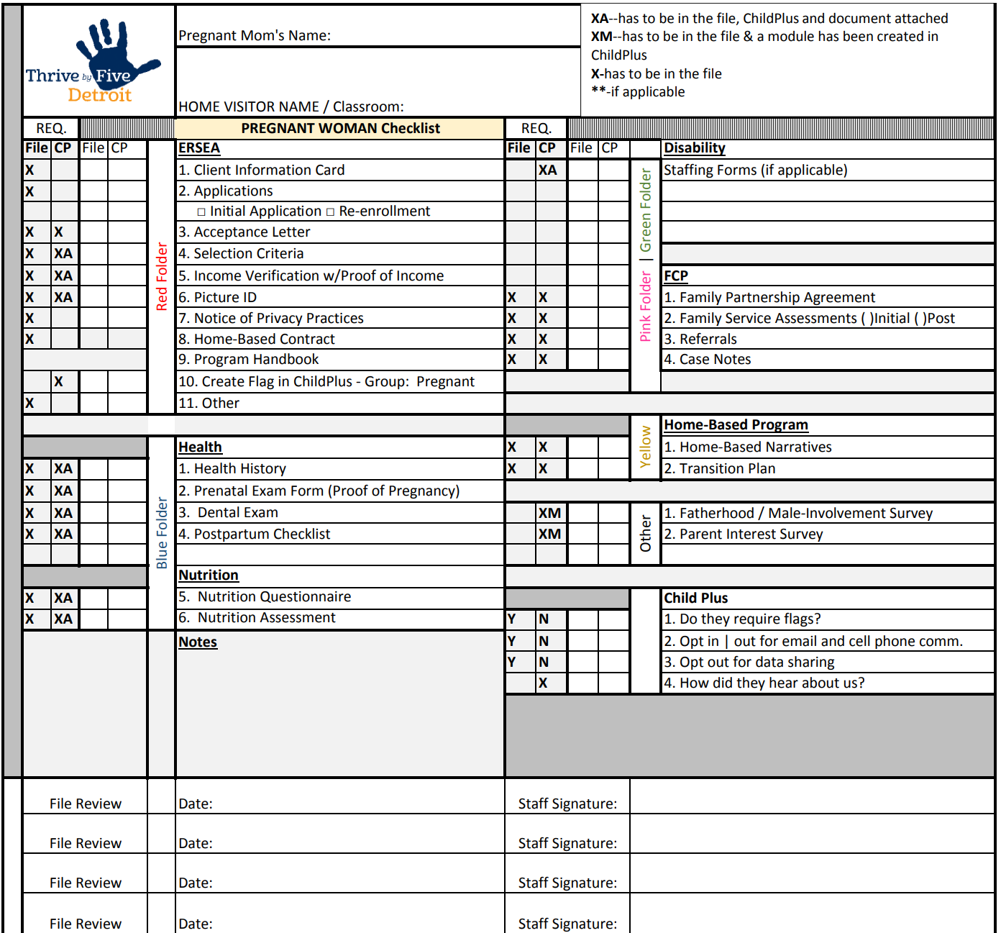
Pregnant Mom File Checklist

Slide 32
(Family And Child Tracking) File Audit
Lindsay Lohan
F.A.C.T.
Assessment
F.A.C.T –(Family And Child Tracking) File Audit

Slide 33
F.A.C.T –(Family And Child Tracking) File Audit
Grantee designated monitoring team will review 10% of files.
Grantee Team members will monitor utilizing the CP monitoring tool.
Grantee will create monitoring results and Delegates will develop a CAP based on non-compliances if needed.
Monitoring Manager will follow-up with Delegate in agreed time frame.
Delegates will do 100% self-monitoring in early fall.
Enter all data into Child Plus.
Follow-up and correct any non-compliances within time-frame.

Slide 34
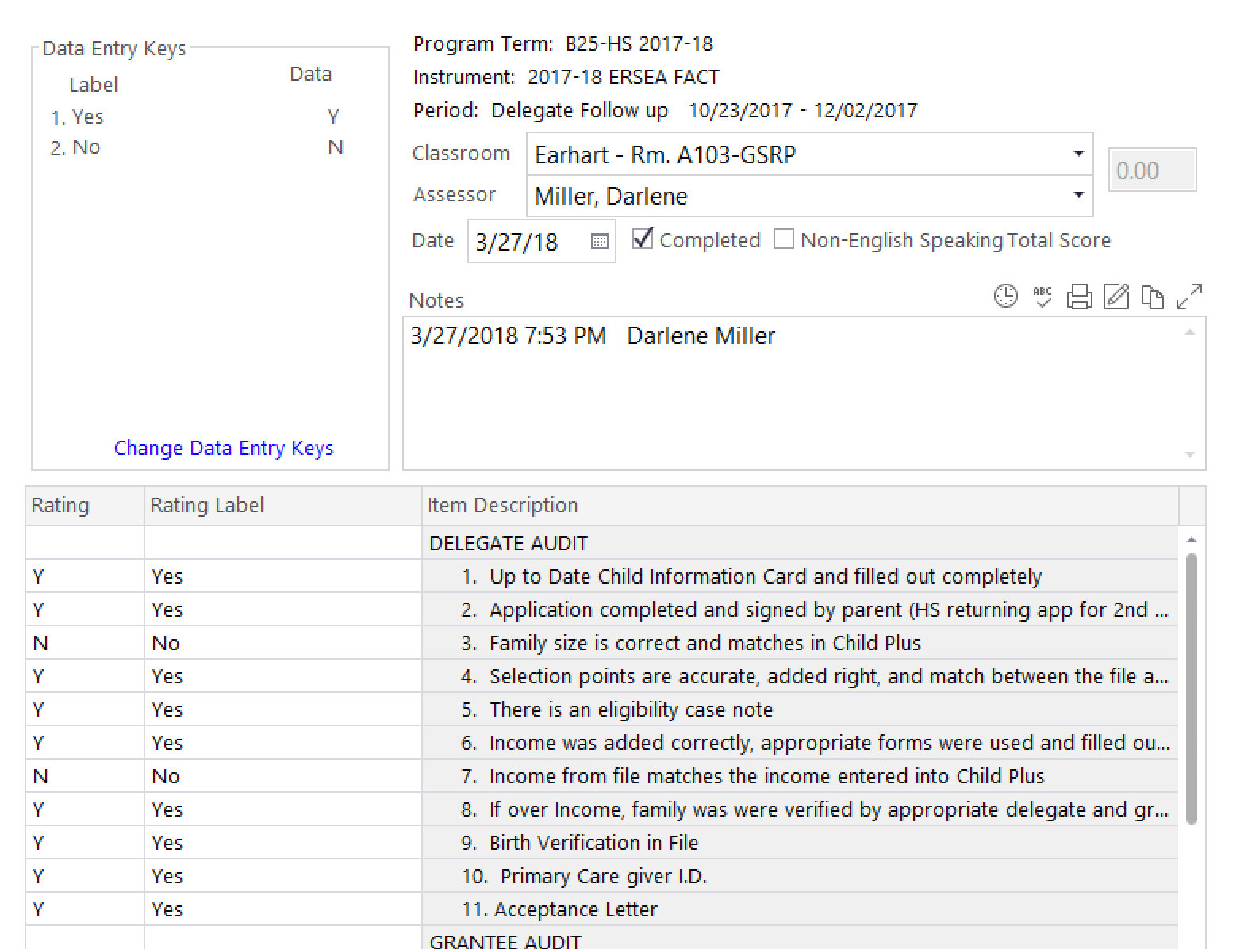
(Family And Child Tracking) File Audit
F.A.C.T.
Assessment

Slide 35
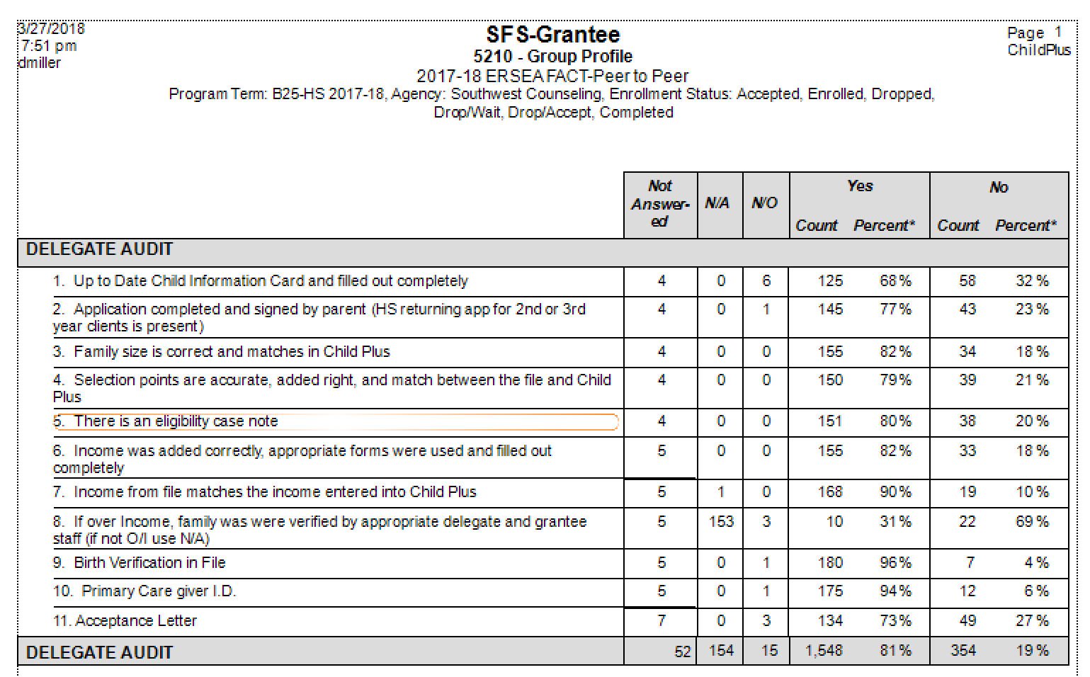

Slide 36
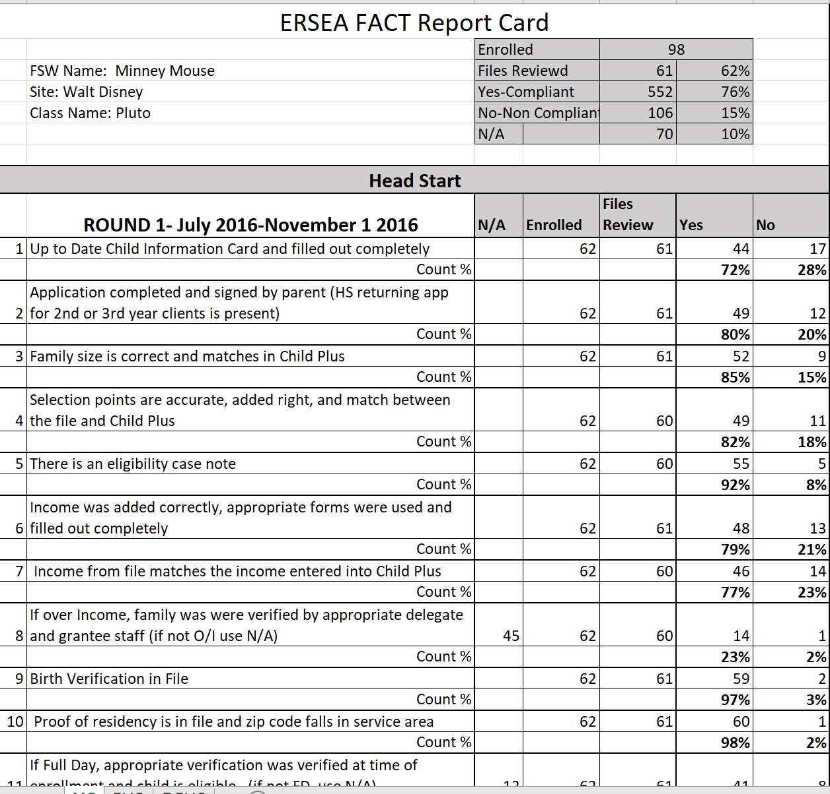
Report Card
ChildPlus

Slide 37
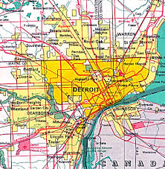
Starting your own Monitoring & Data Trip

Slide 38
Monitoring & Data
PIR
Well-Baby
Mental Health
Physicals
Disabilities
Dental | Orals
Referrals
Lead
Hemoglobin's
Vision
Hearing
Health & Safety
Checklist

Slide 39
Create your own
Manual
Health

Slide 40
You are now a Grantee Director
How would it be if you were the Grantee Director ?
How would you monitor and collect data?

Slide 41
The finish line
Start out strong! End Strong!
Don’t finish on “E”

Slide 42
Build Your Own Road Map

Slide 43
Thank You!
Data
Monitor
Report Out
Value
Train your staff

